Slide 1

Using Explainable AI to Assess Machine Learning Models on the Forecasting of Hospital Mortality in COVID-19 Patients
Greg Gipson
https://github.com/gregg2024/AI_in_HC_FinalProject

Slide 2
Workflow
Using Explainable AI to Assess Machine Learning Models on the Forecasting of Hospital Mortality in COVID-19 Patients
Data Acquisition
Data Processing & Feature Selection
Model Selection
XGBoost
Model Analysis & Evaluation
Glassbox/Blackbox
Model Analysis & Evaluation
Neural Network
Model Analysis & Evaluation
Performance
XAI
EBM
Decision Tree
PCA
Captum
SHAP
Primary focus of the research paper
LIME
ELI5
Referenced in the paper, included in code & this presentation

Slide 3
Setup
import pandas as pd
import numpy as np
import matplotlib.pyplot as plt
import matplotlib.ticker as ticker
import seaborn as sns
import datetime
from google.colab import drive
drive.mount('/content/drive')

Slide 4
Data Acquisition
Data hosted within SyntheticMass has been generated by SyntheaTM, an open-source patient population simulation made available by The MITRE Corporation.
The data is free from cost, privacy, and security restrictions. It can be used without restriction for a variety of secondary uses in academia, research, industry, and government.
Data used: Specialized Data Sets – COVID-19
Download files from https://mitre.box.com/shared/static/wk3560f962ozlg7sd2oj1zxk73ayqvm0.zip and save onto Google drive
Data is based on 100,000 synthetic patients records with COVID-19
conditions = pd.read_csv('drive/MyDrive/AIHealthTutorial/Online/Final_Project/conditions.csv')
patients = pd.read_csv('drive/MyDrive/AIHealthTutorial/Online/Final_Project /patients.csv')
observations = pd.read_csv('drive/MyDrive/AIHealthTutorial/Online/Final_Project /observations.csv')
care_plans = pd.read_csv('drive/MyDrive/AIHealthTutorial/Online/Final_Project /careplans.csv')
encounters = pd.read_csv('drive/MyDrive/AIHealthTutorial/Online/Final_Project /encounters.csv')
procedures = pd.read_csv('drive/MyDrive/AIHealthTutorial/Online/Final_Project /procedures.csv')

Slide 5
Prep for Analysis
#get the code for COVID-19
covid_code = conditions.loc[conditions['DESCRIPTION'] == 'COVID-19', 'CODE'].values[0]
covid_code
#get the observation code for COVID-19
obs_code = observations.loc[observations['DESCRIPTION'] == 'SARS-CoV-2 RNA Pnl Resp NAA+probe', 'CODE'].values[0]
obs_code
#get the care plan code for COVID-19
care_code = care_plans.loc[care_plans['REASONDESCRIPTION'] == 'COVID-19', 'CODE'].values[0]
care_code
#get the encounter code for COVID-19 admissions
enctr_code = encounters.loc[encounters['REASONDESCRIPTION'] == 'COVID-19', 'CODE'].values[0]
enctr_code

Slide 6
Prep for Analysis
#Grab the IDs of patients that have been diagnosed with COVID-19
covid_patient_ids = conditions[conditions.CODE == covid_code].PATIENT.unique()
#Grab every patient with a negative SARS-CoV-2 test. This will include patients who tested negative up front as well as patients that tested negative after leaving the hospital
negative_covid_patient_ids = observations[(observations.CODE == obs_code) & (observations.VALUE == 'Not detected (qualifier value)')].PATIENT.unique()
#Grabs IDs for all patients that died in the simulation. This will be more than just COVID-19 deaths.
deceased_patients = patients[patients.DEATHDATE.notna()].Id
#Grabs IDs for patients that have completed the care plan for isolation at home.
completed_isolation_patients = care_plans[(care_plans.CODE == care_code) & (care_plans.STOP.notna()) & (care_plans.REASONCODE == covid_code)].PATIENT
#Survivors are the union of those who have completed isolation at home or have a negative SARS-CoV-2 test.
survivor_ids = np.union1d(completed_isolation_patients, negative_covid_patient_ids)
#Grab IDs for patients with admission due to COVID-19
inpatient_ids = encounters[(encounters.REASONCODE == covid_code) & (encounters.CODE == enctr_code)].PATIENT
#The number of inpatient survivors
print('Dataset has {} number of inpatient survivors.'.format(len(np.intersect1d(inpatient_ids, survivor_ids))))
#The number of inpatient non-survivors
print('Dataset has {} number of inpatient deaths.'.format(len(np.intersect1d(inpatient_ids, deceased_patients))))
Dataset has 14654 number of inpatient survivors.
Dataset has 3548 number of inpatient deaths.

Slide 7
Prep for Analysis
#Lab values for COVID-19 patients to be used in assessing patient mortality
#Select lab values of interest from all observations in the simulation.
lab_obs = observations[ (observations.CODE == '48065-7') | (observations.CODE == '26881-3') |
(observations.CODE == '2276-4') | (observations.CODE == '89579-7') |
(observations.CODE == '731-0') | (observations.CODE == '14804-9')
]
#Select COVID-19 conditions out of all conditions in the simulation
covid_conditions = conditions[conditions.CODE == covid_code]
#Merge the COVID-19 conditions with the patients
covid_patients = covid_conditions.merge(patients, how='left', left_on='PATIENT', right_on='Id')
#Add an attribute to the DataFrame indicating whether this is a survivor or not.
covid_patients['survivor'] = covid_patients.PATIENT.isin(survivor_ids)
#Reduce the columns on the DataFrame to ones needed
covid_patients = covid_patients[['START', 'PATIENT', 'survivor', 'CODE']]
#Calculate attributes needed to support the plot. Also coerce all lab values into a numeric data type.
covid_patients_obs = covid_patients.merge(lab_obs, on='PATIENT')
covid_patients_obs['START'] = pd.to_datetime(covid_patients_obs.START)
covid_patients_obs['DATE'] = pd.to_datetime(covid_patients_obs.DATE)
covid_patients_obs['lab_days'] = covid_patients_obs.DATE - covid_patients_obs.START
covid_patients_obs['days'] = covid_patients_obs.lab_days / np.timedelta64(1, 'D')
covid_patients_obs['VALUE'] = pd.to_numeric(covid_patients_obs['VALUE'], errors='coerce')
loinc_to_display = {'CODE_y = 48065-7': 'D-dimer', 'CODE_y = 2276-4': 'Serum Ferritin',
'CODE_y = 89579-7': 'High Sensitivity Cardiac Troponin I',
'CODE_y = 26881-3': 'IL-6', 'CODE_y = 731-0': 'Lymphocytes',
'CODE_y = 14804-9': 'Lactate dehydrogenase'}
catplt = sns.catplot(x="days", y="VALUE", hue="survivor", kind="point", col='CODE_y',
col_wrap=2, sharey=False, sharex=False, data=covid_patients_obs, palette=["C1", "C0"])
for axis in catplt.fig.axes:
axis.xaxis.set_major_formatter(ticker.FormatStrFormatter('%d'))
axis.xaxis.set_major_locator(ticker.MultipleLocator(base=4))
axis.set_title(loinc_to_display[axis.title.get_text()])
plt.show()

Slide 8
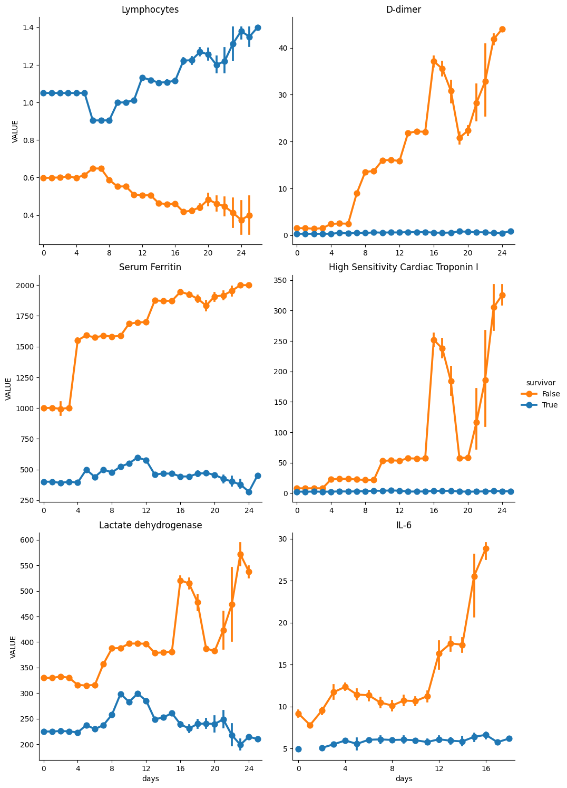
Prep for Analysis
With visual inspection of the above charts, we can determine break points between patient survival and mortality for future use.
D-dimer: 5
Serum Ferritin: 750
High Sensitivity Cardiac Troponin I: 20
IL-6: 8
Lymphocytes: 0.80
Lactate dehydrogenase: 300
#set thresholds
dimer_threshold = 5
ferritin_threshold = 750
hsct_threshold = 20
ilsix_threshold = 8
lymph_threshold = 0.8
lactate_threshold = 300

Slide 9
Prep for Analysis
#check survival and death cases to see if any fall outside of the thresholds. All values should be zero.
#'CODE_y = 48065-7': 'D-dimer'
#'CODE_y = 2276-4': 'Serum Ferritin',
#'CODE_y = 89579-7': 'High Sensitivity Cardiac Troponin I'
#'CODE_y = 26881-3': 'IL-6'
#'CODE_y = 731-0': 'Lymphocytes'
#'CODE_y = 14804-9': 'Lactate dehydrogenase'
print('For patients who survived:')
count_above_threshold = ((covid_patients_obs['CODE_y'] == '48065-7') & (covid_patients_obs['VALUE'] > dimer_threshold) & (covid_patients_obs['survivor'] == 'True')).sum()
print('There are {} above the D-dimer threshold'.format(count_above_threshold))
count_above_threshold = ((covid_patients_obs['CODE_y'] == '2276-4') & (covid_patients_obs['VALUE'] > ferritin_threshold) & (covid_patients_obs['survivor'] == 'True')).sum()
print('There are {} above the Serum Ferritin threshold'.format(count_above_threshold))
count_above_threshold = ((covid_patients_obs['CODE_y'] == '89579-7') & (covid_patients_obs['VALUE'] > hsct_threshold) & (covid_patients_obs['survivor'] == 'True')).sum()
print('There are {} above the High Sensitivity Cardiac Troponin I threshold'.format(count_above_threshold))
count_above_threshold = ((covid_patients_obs['CODE_y'] == '26881-3') & (covid_patients_obs['VALUE'] > ilsix_threshold) & (covid_patients_obs['survivor'] == 'True')).sum()
print('There are {} above the IL-6 threshold'.format(count_above_threshold))
count_below_threshold = ((covid_patients_obs['CODE_y'] == '731-0') & (covid_patients_obs['VALUE'] < lymph_threshold) & (covid_patients_obs['survivor'] == 'True')).sum()
print('There are {} below the Lymphocytes threshold noting that low lymphocytes reflect low white blood cells critical for the immune system '.format(count_below_threshold))
count_above_threshold = ((covid_patients_obs['CODE_y'] == '14804-9') & (covid_patients_obs['VALUE'] > lactate_threshold) & (covid_patients_obs['survivor'] == 'True')).sum()
print('There are {} above the Lactate dehydrogenase threshold'.format(count_above_threshold))
print('')
print('For patients who died:')
count_above_threshold = ((covid_patients_obs['CODE_y'] == '48065-7') & (covid_patients_obs['VALUE'] <= dimer_threshold) & (covid_patients_obs['survivor'] == 'False')).sum()
print('There are {} below the D-dimer threshold'.format(count_above_threshold))
count_above_threshold = ((covid_patients_obs['CODE_y'] == '2276-4') & (covid_patients_obs['VALUE'] <= ferritin_threshold) & (covid_patients_obs['survivor'] == 'False')).sum()
print('There are {} below the Serum Ferritin threshold'.format(count_above_threshold))
count_above_threshold = ((covid_patients_obs['CODE_y'] == '89579-7') & (covid_patients_obs['VALUE'] <= hsct_threshold) & (covid_patients_obs['survivor'] == 'False')).sum()
print('There are {} below the High Sensitivity Cardiac Troponin I threshold'.format(count_above_threshold))
count_above_threshold = ((covid_patients_obs['CODE_y'] == '26881-3') & (covid_patients_obs['VALUE'] <= ilsix_threshold) & (covid_patients_obs['survivor'] == 'False')).sum()
print('There are {} below the IL-6 threshold'.format(count_above_threshold))
count_below_threshold = ((covid_patients_obs['CODE_y'] == '731-0') & (covid_patients_obs['VALUE'] >= lymph_threshold) & (covid_patients_obs['survivor'] == 'False')).sum()
print('There are {} above the Lymphocytes threshold noting that low lymphocytes reflect low white blood cells critical for the immune system'.format(count_below_threshold))
count_above_threshold = ((covid_patients_obs['CODE_y'] == '14804-9') & (covid_patients_obs['VALUE'] <= lactate_threshold) & (covid_patients_obs['survivor'] == 'False')).sum()
print('There are {} below the Lactate dehydrogenase threshold'.format(count_above_threshold))

Slide 10
Prep for Analysis
For patients who survived:
There are 0 above the D-dimer threshold
There are 0 above the Serum Ferritin threshold
There are 0 above the High Sensitivity Cardiac Troponin I threshold
There are 0 above the IL-6 threshold
There are 0 below the Lymphocytes threshold noting that low lymphocytes reflect low white blood cells critical for the immune system
There are 0 above the Lactate dehydrogenase threshold
For patients who died:
There are 0 below the D-dimer threshold
There are 0 below the Serum Ferritin threshold
There are 0 below the High Sensitivity Cardiac Troponin I threshold
There are 0 below the IL-6 threshold
There are 0 above the Lymphocytes threshold noting that low lymphocytes reflect low white blood cells critical for the immune system
There are 0 below the Lactate dehydrogenase threshold

Slide 11
Creating the dataframes for analysis
#Set up a new DataFrame with boolean columns representing various outcomes, like admit, recovery or death
cp = covid_conditions.merge(patients, how='left', left_on='PATIENT', right_on='Id')
isolation_ids = care_plans[(care_plans.CODE == care_code) & (care_plans.REASONCODE == covid_code)].PATIENT
cp['isolation'] = cp.Id.isin(isolation_ids)
cp['admit'] = cp.Id.isin(inpatient_ids)
cp['recovered'] = cp.Id.isin(survivor_ids)
cp['death'] = cp.DEATHDATE.notna()
icu_ids = encounters[encounters.CODE == 305351004].PATIENT
cp['icu_admit'] = cp.Id.isin(icu_ids)
vent_ids = procedures[procedures.CODE == 26763009].PATIENT
cp['ventilated'] = cp.Id.isin(vent_ids)
 | Outcome | All Patients | Hospitalized | ICU Admitted | Required Ventilation
0 | Recovered | 0.959724 | 0.806272 | 0.320914 | 0.14825
1 | Death | 0.041297 | 0.195103 | 0.679358 | 0.85175
For those patients that died, ICU admittance and ventilation have relatively higher percentages than those that survived.
#Outcomes for all COVID-19 Patients
#This DataFrame contains the percentages of patients that either recovered or passed away.
hospitalized = (cp.admit == True)
icu = (cp.icu_admit == True)
vent = (cp.ventilated == True)
covid_count = cp.Id.size
row_filters = {'Recovered': (cp.recovered == True), 'Death': (cp.death == True)}
table_rows = []
for category, row_filter in row_filters.items():
row = {'Outcome': category}
row['All Patients'] = cp[row_filter].Id.size / covid_count
row['Hospitalized'] = cp[row_filter & hospitalized].Id.size / hospitalized.value_counts()[True]
row['ICU Admitted'] = cp[row_filter & icu].Id.size / icu.value_counts()[True]
row['Required Ventilation'] = cp[row_filter & vent].Id.size / vent.value_counts()[True]
table_rows.append(row)
pd.DataFrame.from_records(table_rows)

Slide 12
Creating the dataframes for analysis
#Start to build a DataFrame that we can use to look at other conditions in relation to COVID-19
covid_info = cp[['PATIENT', 'recovered', 'death', 'START', 'DEATHDATE', 'BIRTHDATE', 'GENDER', 'admit', 'icu_admit']]
covid_info = covid_info.rename(columns={'START': 'covid_start'})
#Grab all of the conditions starting after January 20, 2020. This is a hack to get only conditions that are related to COVID-19. We will end up merging these with the COVID patients.
covid_related_conditions = conditions[pd.to_datetime(conditions.START) > pd.to_datetime('2020-01-20')]
#This DataFrame will contain all conditions for COVID-19 patients, where START can be compared to covid_start to see how long after the COVID-19 diagnosis something happened.
covid_patient_conditions = covid_info.merge(covid_related_conditions, on='PATIENT')
#Symptoms for ICU admitted COVID-19 Patients
#Create a DataFrame with columns that show a condition's start and end in days relative to COVID-19 diagnosis. Also create a column that calculates the number of days between COVID-19 diagnosis and a person's death.
covid_patient_conditions['start_days'] = (pd.to_datetime(covid_patient_conditions.START) - pd.to_datetime(covid_patient_conditions.covid_start)) / np.timedelta64(1, 'D')
covid_patient_conditions['end_days'] = (pd.to_datetime(covid_patient_conditions.STOP) - pd.to_datetime(covid_patient_conditions.covid_start)) / np.timedelta64(1, 'D')
covid_patient_conditions['death_days'] = (pd.to_datetime(covid_patient_conditions.DEATHDATE) - pd.to_datetime(covid_patient_conditions.covid_start)) / np.timedelta64(1, 'D')
#Add an age column to the DataFrame for rows where the patient has died
covid_info.loc[covid_info.death == True, 'age'] = (pd.to_datetime(covid_info.DEATHDATE) - pd.to_datetime(covid_info.BIRTHDATE)) / np.timedelta64(1, 'Y')
#Populate ages for survivors based on the current date
covid_info.loc[covid_info.recovered == True, 'age'] = (datetime.datetime.now() - pd.to_datetime(covid_info.BIRTHDATE)) / np.timedelta64(1, 'Y')
#Create an age_range column that places individuals into 10 year age ranges, such as 0 - 10, 10 - 20, etc.
bins = list(range(0, 120, 10))
covid_info['age_range'] = pd.cut(covid_info.age, bins=bins)

Slide 13
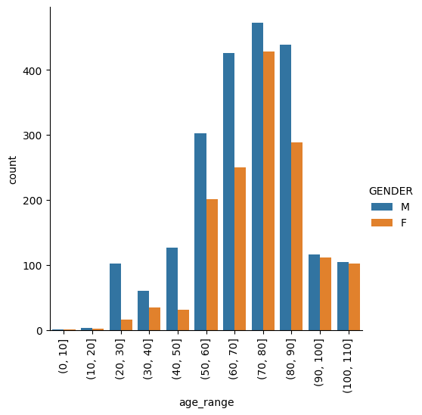
Creating the dataframes for analysis
#Mortality by Age and Sex
#A plot of deaths grouped by age range and gender.
chart = sns.catplot(x="age_range", kind="count", hue="GENDER", data=covid_info[covid_info.death==True]);
for axes in chart.axes.flat:
axes.set_xticklabels(axes.get_xticklabels(), rotation=90)

Slide 14
Creating the dataframes for analysis
Let's clean up and create a dataframe for our model.
#Create a new column for length of stay/hospitalization for survivors and days until death for those who died
# Define a custom function to calculate the maximum value relative to the difference between two columns
def calculate_max(col1_val, col2_val, col3_val):
return max(col1_val, col2_val - col3_val)
# Apply the custom function to create a new column
covid_patient_conditions['death_days'].fillna(0, inplace=True)
covid_patient_conditions['LOS'] = covid_patient_conditions.apply(lambda row: calculate_max(row['death_days'], row['end_days'], row['start_days']), axis=1)
covid_patient_conditions.iloc[:,[0,17]]
#Create a dataframe of smoking status
smoker_df = pd.DataFrame()
smoker_df = observations[observations['DESCRIPTION'] == 'Tobacco smoking status NHIS']
smoker_df.rename(columns={'VALUE': 'smoker'}, inplace=True)
smoker_df.iloc[:,[1,5]]
#Create a dataframe of body mass index
bmi_df = pd.DataFrame()
bmi_df = observations[observations['DESCRIPTION'] == 'Body Mass Index']
bmi_df.rename(columns={'VALUE': 'BMI'}, inplace=True)
# Convert the 'BMI' column to integer
bmi_df['BMI'] = bmi_df['BMI'].astype(float)
bmi_df['BMI'] = bmi_df['BMI'].astype(int)
bmi_df.iloc[:,[1,5]]
#merge multiple dataframes into our analysis dataframe
cpobs_short = covid_patients_obs.iloc[:,[1,6,8]]
cp_short = cp.iloc[:,[2, 31, 36]]
ccond_short = covid_patient_conditions.iloc[:,[0,17]]
covid_df = pd.DataFrame()
covid_df = pd.merge(covid_patients, covid_info, on='PATIENT')
covid_df = pd.merge(covid_df, cpobs_short, on='PATIENT')
covid_df = pd.merge(covid_df, cp_short, on='PATIENT')
covid_df = pd.merge(covid_df, ccond_short, on='PATIENT’)
covid_df = pd.merge(covid_df, smoker_short, on='PATIENT')
covid_df = pd.merge(covid_df, bmi_short, on='PATIENT')
covid_df.head(2)

Slide 15
Creating the dataframes for analysis
#Convert the text to numbers for use in machine learning
#CODE_y = 48065-7: D-dimer
#CODE_y = 2276-4: Serum Ferritin
#CODE_y = 89579-7: High Sensitivity Cardiac Troponin I
#CODE_y = 26881-3: IL-6
#CODE_y = 731-0: Lymphocytes
#CODE_y = 14804-9: Lactate dehydrogenase
#create new columns by converting text-based variables to integers and lab-item specific columns for their values
covid_df['death'] = covid_df['death'].replace({True: 1, False: 0})
covid_df['admit'] = covid_df['admit'].replace({True: 1, False: 0})
covid_df['icu_admit'] = covid_df['icu_admit'].replace({True: 1, False: 0})
covid_df['isolation'] = covid_df['isolation'].replace({True: 1, False: 0})
covid_df['ventilated'] = covid_df['ventilated'].replace({True: 1, False: 0})
covid_df['is_male'] = covid_df['GENDER'].apply(lambda x: 1 if x == 'M' else 0)
covid_df['d_dimer'] = covid_df['CODE_y'].apply(lambda x: 1 if x == '48065-7' else 0) * covid_df['VALUE']
covid_df['serum_ferritin'] = covid_df['CODE_y'].apply(lambda x: 1 if x == '2276-4' else 0) * covid_df['VALUE']
covid_df['hi_sens_card_trop'] = covid_df['CODE_y'].apply(lambda x: 1 if x == '89579-7' else 0) * covid_df['VALUE']
covid_df['il_six'] = covid_df['CODE_y'].apply(lambda x: 1 if x == '26881-3' else 0) * covid_df['VALUE']
covid_df['lymphocytes'] = covid_df['CODE_y'].apply(lambda x: 1 if x == '731-0' else 0) * covid_df['VALUE']
covid_df['lactate_dehydrogenase'] = covid_df['CODE_y'].apply(lambda x: 1 if x == '14804-9' else 0) * covid_df['VALUE’]
#adjust smoker column from text to numbers
def change_smoker(x):
if x == 'Never smoker':
return 0
elif x == 'Former smoker': #for former smokers we will use 0.5 to differentiate from current and non-smokers
return 0.5
else:
return 1 #current smokers will be 1
covid_df['smoker'] = covid_df['smoker'].apply(change_smoker)
#Clean up and drop unnecessary columns
covid_df = covid_df.drop(columns=['survivor'])
covid_df = covid_df.drop(columns=['admit']) #drop hospital admission as all patients in this sample were admitted
covid_df = covid_df.drop(columns=['DEATHDATE'])
covid_df = covid_df.drop(columns=['BIRTHDATE'])
covid_df = covid_df.drop(columns=['age_range'])
covid_df = covid_df.drop(columns=['GENDER'])
covid_df = covid_df.drop(columns=['START'])
covid_df = covid_df.drop(columns=['recovered'])
covid_df = covid_df.drop(columns=['covid_start'])
covid_df = covid_df.drop(columns=['CODE_y'])
covid_df = covid_df.drop(columns=['VALUE'])
covid_df = covid_df.drop(columns=['CODE'])
covid_df.head(2)
 | PATIENT | death | icu_admit | age | isolation | ventilated | LOS | smoker | BMI | is_male | d_dimer | serum_ferritin | hi_sens_card_trop | il_six | lymphocytes | lactate_dehydrogenase
0 | 3c3b89b1-cb41-4f94-9193-2f3da4fe38e5 | 0 | 0 | 40.587839 | 0 | 0 | 13.0 | 0.0 | 28 | 0 | 0.0 | 0.0 | 0.0 | 0.0 | 1.0 | 0.0
1 | 3c3b89b1-cb41-4f94-9193-2f3da4fe38e5 | 0 | 0 | 40.587839 | 0 | 0 | 13.0 | 0.0 | 28 | 0 | 0.0 | 0.0 | 0.0 | 0.0 | 1.0 | 0.0

Slide 16
Creating the dataframes for analysis
#combine rows by patient using the maximum value of each variable
covid_df = covid_df.groupby('PATIENT').max()
#save dataframe for use in regression
covid_df_reg = pd.DataFrame()
covid_df_reg = covid_df
#remove the patient indexing for future ease of use
reset_covid_df_reg = pd.DataFrame()
reset_covid_df_reg = covid_df_reg.reset_index()
reset_covid_df_reg = reset_covid_df_reg.drop(columns=['PATIENT'])
reset_covid_df_reg.head(2)
 | death | icu_admit | age | isolation | ventilated | LOS | smoker | BMI | is_male | d_dimer | serum_ferritin | hi_sens_card_trop | il_six | lymphocytes | lactate_dehydrogenase
0 | 0 | 0 | 65.431674 | 0 | 0 | 13.0 | 0.0 | 27 | 0 | 0.6 | 633.3 | 5.0 | 0.0 | 1.2 | 324.1
1 | 0 | 0 | 40.300167 | 0 | 0 | 11.0 | 0.0 | 37 | 0 | 0.6 | 533.0 | 4.1 | 0.0 | 1.1 | 294.8

Slide 17
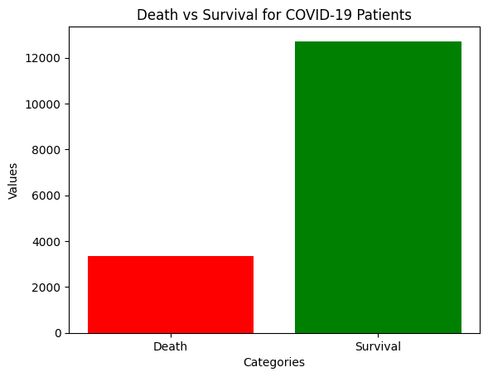
Balance Data
#check the data for balance
import matplotlib.pyplot as plt
# Data
labels = ['Death', 'Survival']
values = [reset_covid_df_reg['death'].value_counts()[1], reset_covid_df_reg['death'].value_counts()[0]]
# Create a bar plot
plt.bar(labels, values, color=['red', 'green'])
plt.xlabel('Categories')
plt.ylabel('Values')
plt.title('Death vs Survival for COVID-19 Patients')
plt.show()

Slide 18
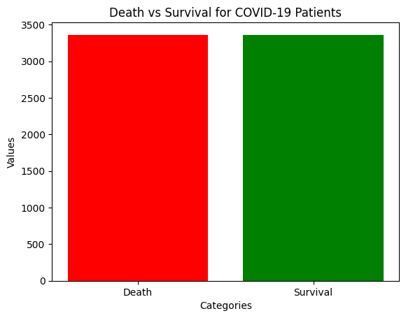
Balance Data
#Balancing the class distribution using undersampling.
# Count the occurrences of each class
class_counts = reset_covid_df_reg['death'].value_counts()
# Find the minority class label (1 in this case)
minority_class = class_counts.idxmin()
# Calculate the number of samples in the minority class
minority_count = class_counts[minority_class]
# Find the indices of the majority class samples (0 in this case)
majority_indices = reset_covid_df_reg[reset_covid_df_reg['death'] == 0].index
# Randomly select a subset of majority class indices to match the minority class count
undersampled_majority_indices = np.random.choice(majority_indices, size=minority_count, replace=False)
# Concatenate the minority class indices with the undersampled majority class indices
undersampled_indices = pd.Index(undersampled_majority_indices).union(reset_covid_df_reg[reset_covid_df_reg['death'] == 1].index)
# Create the balanced DataFrames
final_covid_df = reset_covid_df_reg.loc[undersampled_indices].reset_index(drop=True)
#check the data for balancing after undersampling
# Data
labels = ['Death', 'Survival']
values = [final_covid_df['death'].value_counts()[1], final_covid_df['death'].value_counts()[0]]
# Create a bar plot
plt.bar(labels, values, color=['red', 'green'])
plt.xlabel('Categories')
plt.ylabel('Values')
plt.title('Death vs Survival for COVID-19 Patients')
plt.show()

Slide 19
Data Visualization
Let's view correlations between the different features.
selected_columns = final_covid_df.iloc[:, [0] + list(range(1, len(final_covid_df.columns)))]
# Create a correlation matrix
correlation_matrix = selected_columns.corr()
# Plotting the heatmap
plt.figure(figsize=(8, 6))
sns.heatmap(correlation_matrix, annot=True, cmap='coolwarm', fmt=".2f", linewidths=.5)
plt.title('Correlation Matrix for All Features')
plt.show()
print('')
selected_columns_lab = final_covid_df.iloc[:, [0] + list(range(9, len(final_covid_df.columns)))]
# Create a correlation matrix
correlation_matrix = selected_columns_lab.corr()
# Plotting the heatmap
plt.figure(figsize=(8, 6))
sns.heatmap(correlation_matrix, annot=True, cmap='coolwarm', fmt=".2f", linewidths=.5)
plt.title('Correlation Matrix for Lab Features')
plt.show()
print('')
selected_columns_nl = final_covid_df.iloc[:, [0] + list(range(1, 8))]
# Create a correlation matrix
correlation_matrix = selected_columns_nl.corr()
# Plotting the heatmap
plt.figure(figsize=(8, 6))
sns.heatmap(correlation_matrix, annot=True, cmap='coolwarm', fmt=".2f", linewidths=.5)
plt.title('Correlation Matrix for Non-Lab Features')
plt.show()

Slide 20
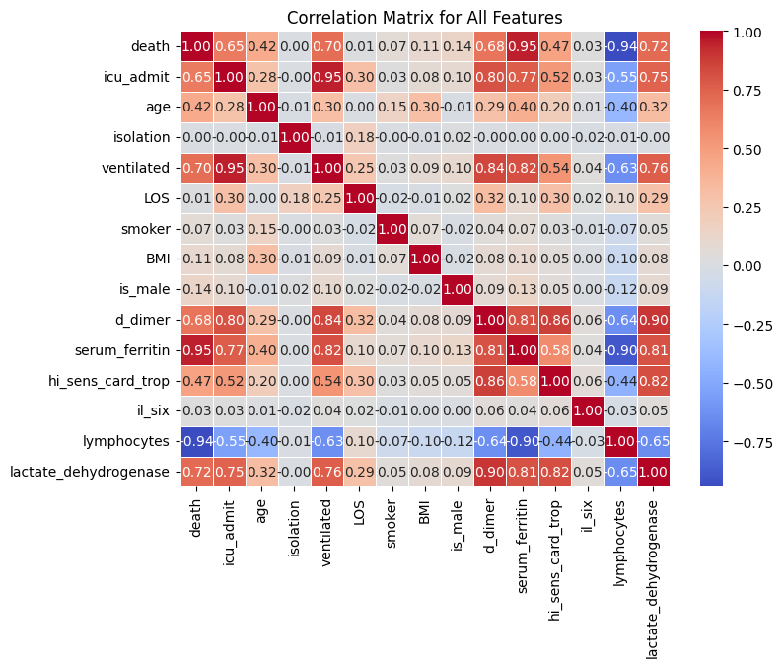
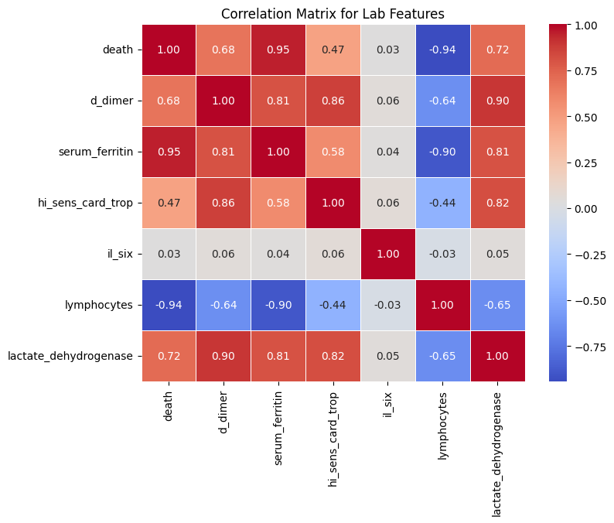
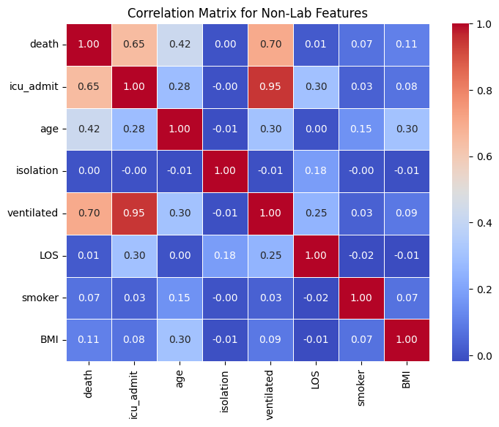
Data Visualization
Recall that low lymphocytes factor in mortality prediction so the negative correlations are sensible. Adjusting for this, we see that the lab results are generally highly correlated with each other and with mortality while the non-lab features generally see lower correlation with each other and with mortality.

Slide 21
Creating the dataframes for analysis
#We will create a second dataframe that drops the lab results
nonlab_final_covid_df = final_covid_df.copy()
#Clean up and drop unnecessary columns
nonlab_final_covid_df = nonlab_final_covid_df.drop(columns=['d_dimer'])
nonlab_final_covid_df = nonlab_final_covid_df.drop(columns=['serum_ferritin'])
nonlab_final_covid_df = nonlab_final_covid_df.drop(columns=['hi_sens_card_trop'])
nonlab_final_covid_df = nonlab_final_covid_df.drop(columns=['il_six'])
nonlab_final_covid_df = nonlab_final_covid_df.drop(columns=['lymphocytes'])
nonlab_final_covid_df = nonlab_final_covid_df.drop(columns=['lactate_dehydrogenase'])
nonlab_final_covid_df.head(2)
 | death | icu_admit | age | isolation | ventilated | LOS | smoker | BMI | is_male
0 | 0 | 0 | 65.431674 | 0 | 0 | 13.0 | 0.0 | 27 | 0
1 | 1 | 1 | 73.016438 | 0 | 1 | 15.0 | 0.5 | 27 | 0

Slide 22
Data prep for machine learning
#Let's define the target variable and feature variables
#Full dataframe
#Target
Y = final_covid_df['death']
#Features
X = final_covid_df.drop(columns=['death'])
#Non-lab result dataframe
#Target
Y_nl = nonlab_final_covid_df['death']
#Features
X_nl = nonlab_final_covid_df.drop(columns=['death'])
Now we have our dataframes for analysis.

Slide 23
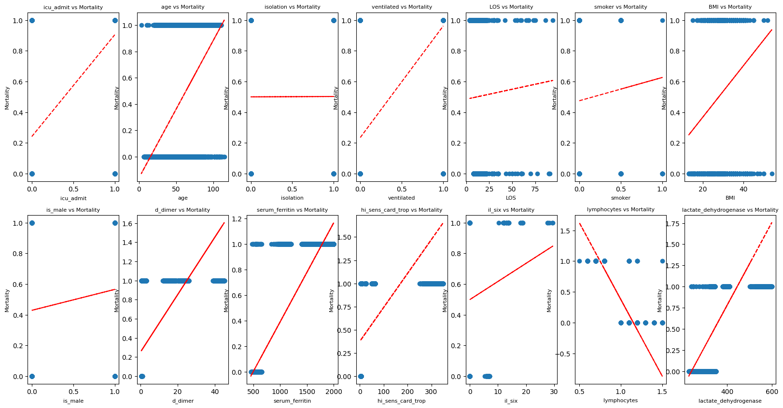
Data Visualization
Quick Data Visualization: Mortality as a function of individual features, including a regression line to get as a complement to the correlations shown above.
feature_names = list(X.columns)
num_rows, num_columns = X.shape
ncols = 7
nrows = int(np.ceil(num_columns / ncols))
fig, axs = plt.subplots(nrows=nrows, ncols=ncols, figsize=(20, 10))
# Set the font size (adjust as needed
font_size = 8
for i, (ax, col) in enumerate(zip(axs.flat, feature_names)):
x = X.iloc[:,i]
pf = np.polyfit(x, Y, 1)
p = np.poly1d(pf)
ax.plot(x, Y, 'o')
ax.plot(x, p(x),"r--")
ax.set_title(col + ' vs Mortality', fontsize=font_size)
ax.set_xlabel(col, fontsize=font_size)
ax.set_ylabel('Mortality', fontsize=font_size)

Slide 24

Machine Learning Modeling

Slide 25
Installation and imports
#Imports
from numpy import mean
from numpy import std
from sklearn.metrics import roc_curve
from sklearn.metrics import roc_auc_score
from sklearn.metrics import multilabel_confusion_matrix
from sklearn.metrics import accuracy_score
from sklearn.metrics import average_precision_score, RocCurveDisplay, f1_score, log_loss
from sklearn.datasets import make_classification
from sklearn.preprocessing import MinMaxScaler
from sklearn.neighbors import KNeighborsClassifier
from sklearn.inspection import permutation_importance
from sklearn.linear_model import SGDClassifier
from sklearn.linear_model import LogisticRegression
from sklearn.ensemble import RandomForestClassifier
from sklearn.ensemble import GradientBoostingClassifier
from sklearn.svm import SVC
from sklearn.model_selection import train_test_split
from sklearn.model_selection import cross_val_score
!pip install xgboost
from xgboost import XGBClassifier
!pip install catboost
from catboost import CatBoostClassifier

Slide 26
Splitting the dataset for use in our machine learning models
# A common approach to splitting is to use a 70-15-15 split, where:
# 70% of the data is allocated to the training set for model training.
# 15% of the data is allocated to the validation set for hyperparameter tuning and model evaluation during training.
# 15% of the data is allocated to the test set for final model evaluation.
#Split the full dataframe into a training set of 70% and validation and test sets of 15% each
test_size = 0.30
seed = 0
X_train, X_test, y_train, y_test = train_test_split(X,
Y,
test_size = test_size,
random_state = seed)
#Split test data equally into validation and test sets
X_valid = X_test.sample(frac = 0.5, random_state=seed)
X_test = X_test.drop(X_valid.index)
y_valid = y_test.sample(frac = 0.5, random_state=seed)
y_test = y_test.drop(y_valid.index)
# Show the results of the split
print("Training set has {} samples.".format(X_train.shape[0]))
print("Testing set has {} samples.".format(X_test.shape[0]))
print("Validation set has {} samples.".format(X_valid.shape[0]))
#Split the non-lab dataframe into a training set of 70% and validation and test sets of 15% each
X_nl_train, X_nl_test, y_nl_train, y_nl_test = train_test_split(X_nl,
Y_nl,
test_size = test_size,
random_state = seed)
#Split test data equally into validation and test sets
X_nl_valid = X_nl_test.sample(frac = 0.5, random_state=seed)
X_nl_test = X_nl_test.drop(X_nl_valid.index)
y_nl_valid = y_nl_test.sample(frac = 0.5, random_state=seed)
y_nl_test = y_nl_test.drop(y_nl_valid.index)
# Show the results of the split
print('')
print("Non-lab Training set has {} samples.".format(X_nl_train.shape[0]))
print("Non-lab Testing set has {} samples.".format(X_nl_test.shape[0]))
print("Non-lab Validation set has {} samples.".format(X_nl_valid.shape[0]))

Slide 27
Model Analysis & Selection
While the referenced paper uses XGBoost, we will test a number of different models to determine their relative effectiveness and use the best model for ongoing analysis.
# Models for comparison
models = [SGDClassifier(loss='log_loss', random_state = 0),
GradientBoostingClassifier(random_state = 0),
LogisticRegression(max_iter=10000, solver='saga'),
KNeighborsClassifier(),
RandomForestClassifier(random_state = 0),
SVC(probability=True),
XGBClassifier(),
CatBoostClassifier(verbose=0)]
results = {}
print('Full Data Set')
for model in models:
# Instantiate and fit Classification Model
reg_model = model
reg_model.fit(X_train, y_train)
# Make predictions with model
y_test_prob = reg_model.predict_proba(X_test)[:,1]
# Grab model name and store results associated with model
name = str(model).split("(")[0]
results[name] = roc_auc_score(y_test, y_test_prob)*100
print('{} done.'.format(name))
results_nl = {}
print('')
print('Non-lab Data Set')
for model in models:
# Instantiate and fit Classification Model
reg_model_nl = model
reg_model_nl.fit(X_nl_train, y_nl_train)
# Make predictions with model
y_test_prob_nl = reg_model_nl.predict_proba(X_nl_test)[:,1]
# Grab model name and store results associated with model
name = str(model).split("(")[0]
results_nl[name] = roc_auc_score(y_nl_test, y_test_prob_nl)*100
print('{} done.'.format(name))

Slide 28
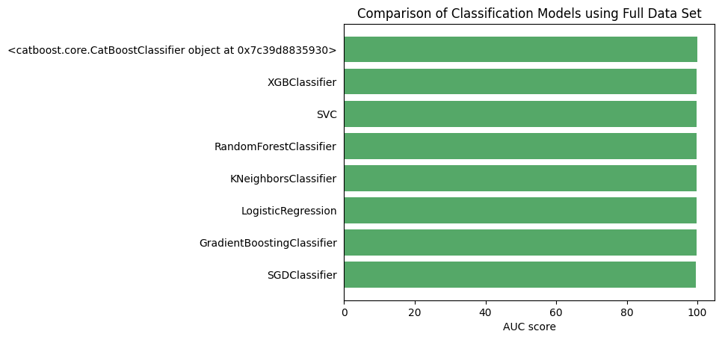
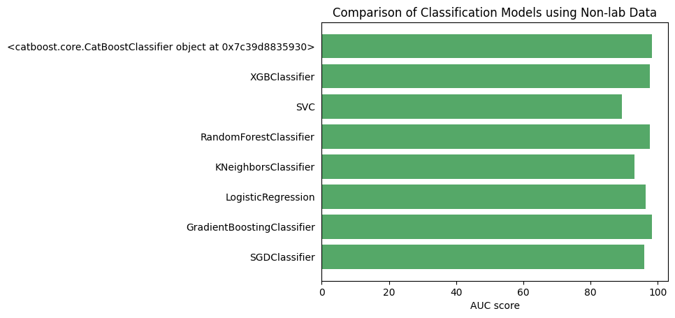
Model Analysis & Selection
# AUC score results
fig, ax = plt.subplots()
ind = range(len(results))
ax.barh(ind, list(results.values()), align='center',
color = '#55a868', alpha=1.0)
ax.set_yticks(ind)
ax.set_yticklabels(results.keys())
ax.set_xlabel('AUC score')
ax.tick_params(left=False, top=False, right=False)
ax.set_title('Comparison of Classification Models')
# AUC score results for non-lab data
fig, ax = plt.subplots()
ind = range(len(results_nl))
ax.barh(ind, list(results_nl.values()), align='center',
color = '#55a868', alpha=1.0)
ax.set_yticks(ind)
ax.set_yticklabels(results_nl.keys())
ax.set_xlabel('AUC score')
ax.tick_params(left=False, top=False, right=False)
ax.set_title('Comparison of Classification Models using Non-lab Data')

Slide 29
Model Analysis & Selection
#sort the results by AUC score with the highest score being desirable to determine the model to use.
sorted_results = sorted(results.items(), key=lambda x: x[1], reverse=True)
print("The {} model generates the highest AUC score on the full dataset.".format(sorted_results[0][0]))
print("The model generates an AUC score of {:.2f}%.".format(sorted_results[0][1]))
print('')
sorted_results_nl = sorted(results_nl.items(), key=lambda x: x[1], reverse=True)
print("The {} model generates the highest AUC score on non-lab dataset.".format(sorted_results_nl[0][0]))
print("The model generates an AUC score of {:.2f}%.".format(sorted_results_nl[0][1]))
# Filter the results to find the value for "XGB"
xgb_result = next((result_value for result_name, result_value in sorted_results if result_name == "XGBClassifier"), None)
xgb_result_nl = next((result_value for result_name, result_value in sorted_results_nl if result_name == "XGBClassifier"), None)
print('')
print("The XGBClassifier model generates an AUC score of {:.2f}% on the full dataset.".format(xgb_result))
print("The XGBClassifier model generates an AUC score of {:.2f}% on the non-lab dataset.".format(xgb_result_nl))
print('')
print('For consistency with the research paper, we will use the XGBClassifier model, noting that its AUC is consistent with that of the optimal models')
The <catboost.core.CatBoostClassifier object at 0x7c39d8835930> model generates the highest AUC score on the full dataset.
The model generates an AUC score of 99.96%.
The <catboost.core.CatBoostClassifier object at 0x7c39d8835930> model generates the highest AUC score on non-lab dataset.
The model generates an AUC score of 98.23%.
The XGBClassifier model generates an AUC score of 99.85% on the full dataset.
The XGBClassifier model generates an AUC score of 97.73% on the non-lab dataset.
For consistency with the research paper, we will use the XGBClassifier model, noting that its AUC is consistent with that of the optimal models.
Please note that due to the dynamic nature of machine learning, user results may differ from those in this presentation.

Slide 30
Model Analysis & Evaluation: Useful Functions
from sklearn.metrics import multilabel_confusion_matrix
#When analyzing the performance of a machine learning model, it is important to consider certain metrics:
#We will use the multi-label confusion matrix which is used for evaluating the performance of a machine learning model.
#tn = True Negative; tp = True Positive; fn = False Negative; fp = False Positive
#Let's create a number of useful functions to calculate metrics to assess the efficacy of our machine learning model.
def calc_accuracy(y_actual, y_pred):
y_true = np.array(y_actual)
y_pred = y_pred
mcm = multilabel_confusion_matrix(y_true, y_pred)
tn = mcm[:, 0, 0]
tp = mcm[:, 1, 1]
fn = mcm[:, 1, 0]
fp = mcm[:, 0, 1]
accuracy = (tp + tn) / (tp + fp + tn + fn)
return accuracy[0]
def calc_recall(y_actual, y_pred):
y_true = np.array(y_actual)
y_pred = y_pred
mcm = multilabel_confusion_matrix(y_true, y_pred)
tn = mcm[:, 0, 0]
tp = mcm[:, 1, 1]
fn = mcm[:, 1, 0]
fp = mcm[:, 0, 1]
recall = tp / (tp + fn)
return recall[0]
def calc_specificity(y_actual, y_pred):
y_true = np.array(y_actual)
y_pred = y_pred
mcm = multilabel_confusion_matrix(y_true, y_pred)
tn = mcm[:, 0, 0]
tp = mcm[:, 1, 1]
fn = mcm[:, 1, 0]
fp = mcm[:, 0, 1]
specificity = tn / (tn + fp)
return specificity[0]
def calc_fallout(y_actual, y_pred):
y_true = np.array(y_actual)
y_pred = y_pred
mcm = multilabel_confusion_matrix(y_true, y_pred)
tn = mcm[:, 0, 0]
tp = mcm[:, 1, 1]
fn = mcm[:, 1, 0]
fp = mcm[:, 0, 1]
fallout = fp / (fp + tn)
return fallout[0]
def calc_missrate(y_actual, y_pred):
y_true = np.array(y_actual)
y_pred = y_pred
mcm = multilabel_confusion_matrix(y_true, y_pred)
tn = mcm[:, 0, 0]
tp = mcm[:, 1, 1]
fn = mcm[:, 1, 0]
fp = mcm[:, 0, 1]
missrate = fn / (fn + tp)
return missrate[0]
def calc_precision(y_actual, y_pred):
y_true = np.array(y_actual)
y_pred = y_pred
mcm = multilabel_confusion_matrix(y_true, y_pred)
tn = mcm[:, 0, 0]
tp = mcm[:, 1, 1]
fn = mcm[:, 1, 0]
fp = mcm[:, 0, 1]
precision = tp / (tp + fp)
return precision[0]

Slide 31
Model Analysis & Evaluation
from sklearn.metrics import multilabel_confusion_matrix
from sklearn.metrics import cohen_kappa_score
from sklearn.metrics import matthews_corrcoef
from sklearn.metrics import brier_score_loss
#We will use the XGB model
model = XGBClassifier()
model.fit(X_train, y_train)
model_nl = XGBClassifier()
model_nl.fit(X_nl_train, y_nl_train)
#Make predictions using the model
#For AUC, we need to predict the probabilities
y_valid_prob = model.predict_proba(X_valid)[:,1]
y_nl_valid_prob = model_nl.predict_proba(X_nl_valid)[:,1]
print('Characteristics are based on the validation set')
print('')
print('Model AUC')
print('Full Data Set: %.2f%%'%(roc_auc_score(y_valid, y_valid_prob)*100))
print('Non-lab Data Set: %.2f%%'%(roc_auc_score(y_nl_valid, y_nl_valid_prob)*100))
print('')
print('Model AUPRC')
print('Full Data Set: %.2f%%'%(average_precision_score(y_valid, y_valid_prob)*100))
print('Non-lab Data Set: %.2f%%'%(average_precision_score(y_nl_valid, y_nl_valid_prob)*100))
print('')
#For characteristics, we need to make predictions, not probabilities
y_valid_preds = model.predict(X_valid)
y_nl_valid_preds = model_nl.predict(X_nl_valid)
print("F1 Score")
print('Full Data Set: %.2f%%'%(f1_score(y_valid, y_valid_preds)*100))
print('Non-lab Data Set: %.2f%%'%(f1_score(y_nl_valid, y_nl_valid_preds)*100))
print('')
print("Log-Loss (Cross-Entropy)")
print('Full Data Set: ', round(log_loss(y_valid, y_valid_preds), 2))
print('Non-lab Data Set: ', round(log_loss(y_nl_valid, y_nl_valid_preds), 2))
print('')
print('Cohen Kappa')
print('Full Data Set: %.2f%%'%(cohen_kappa_score(y_valid, y_valid_preds)*100))
print('Non-lab Data Set: %.2f%%'%(cohen_kappa_score(y_nl_valid, y_nl_valid_preds)*100))
print('')
print('Matthew Correlation Coefficient')
print('Full Data Set: %.2f%%'%(matthews_corrcoef(y_valid, y_valid_preds)*100))
print('Non-lab Data Set: %.2f%%'%(matthews_corrcoef(y_nl_valid, y_nl_valid_preds)*100))
print('')
print('Brier Score')
print('Full Data Set: %.2f%%'%(brier_score_loss(y_valid, y_valid_preds)*100))
print('Non-lab Data Set: %.2f%%'%(brier_score_loss(y_nl_valid, y_nl_valid_preds)*100))
print('')
print('Model Accuracy')
print('Full Data Set: %.2f%%'%(calc_accuracy(y_valid, y_valid_preds)*100))
print('Non-lab Data Set: %.2f%%'%(calc_accuracy(y_nl_valid, y_nl_valid_preds)*100))
print('')
print('Recall: True Positive')
print('Full Data Set: %.2f%%'%(calc_recall(y_valid, y_valid_preds)*100))
print('Non-lab Data Set: %.2f%%'%(calc_recall(y_nl_valid, y_nl_valid_preds)*100))
print('')
print('Specificity: True Negative')
print('Full Data Set: %.2f%%'%(calc_specificity(y_valid, y_valid_preds)*100))
print('Non-lab Data Set: %.2f%%'%(calc_specificity(y_nl_valid, y_nl_valid_preds)*100))
print('')
print('Fall Out: False Positive')
print('Full Data Set: %.2f%%'%(calc_fallout(y_valid, y_valid_preds)*100))
print('Non-lab Data Set: %.2f%%'%(calc_fallout(y_nl_valid, y_nl_valid_preds)*100))
print('')
print('Miss Rate: False Negative')
print('Full Data Set: %.2f%%'%(calc_missrate(y_valid, y_valid_preds)*100))
print('Non-lab Data Set: %.2f%%'%(calc_missrate(y_nl_valid, y_nl_valid_preds)*100))
print('')
print('Precision: Positive Results Relative to Predicted Positive Results')
print('Full Data Set: %.2f%%'%(calc_precision(y_valid, y_valid_preds)*100))
print('Non-lab Data Set: %.2f%%'%(calc_precision(y_nl_valid, y_nl_valid_preds)*100))
print('')

Slide 32
Model Analysis & Evaluation
Output analysis
Metric | Full Data Set | Non-lab Data Set
AUC | 99.87% | 97.32%
AUPRC | 99.91% | 97.24%
F1 Score | 99.71% | 92.54%
Log-Loss (Cross-Entropy) | 0.11 | 2.68
Cohen Kappa | 99.41% | 85.14%
Matthews Correlation Coefficient | 99.41% | 85.19%
Brier Score | 0.003 | 0.0743
Accuracy | 99.70% | 92.57%
Recall: True Positive | 100.00% | 94.18%
Specificity: True Negative | 99.41% | 91.00%
Fall Out: False Positive | 0.59% | 9.00%
Miss Rate: False Negative | 0.00% | 5.82%
Precision | 99.40% | 91.07%
#Model Classification Reports on the Validation Set
from sklearn.metrics import classification_report
print('Classification Report for the Full Data Set')
target_names = ['Survival', 'Death']
print(classification_report(y_valid, y_valid_preds, target_names=target_names))
print('')
print('Classification Report for the Non-lab Data Set')
target_names = ['Survival', 'Death']
print(classification_report(y_nl_valid, y_nl_valid_preds, target_names=target_names))
Classification Report for XGBoost Models
 | precision |  | recall |  | f1-score |  | support
Metric | Full Data | Non-lab Data | Full Data | Non-lab Data | Full Data | Non-lab Data | Full Data | Non-lab Data
Survival | 0.99 | 0.91 | 1.00 | 0.94 | 1.00 | 0.93 | 498 | 498
Death | 1.00 | 0.94 | 0.99 | 0.91 | 1.00 | 0.93 | 511 | 511
accuracy |  |  |  |  | 1.00 | 0.93 | 1009 | 1009
macro avg | 1.00 | 0.93 | 1.00 | 0.93 | 1.00 | 0.93 | 1009 | 1009
weighted avg | 1.00 | 0.93 | 1.00 | 0.93 | 1.00 | 0.93 | 1009 | 1009
Both models demonstrate strong performance across various metrics, indicating their effectiveness in classification tasks. The Full Data Set (FDS) model outperforms the Non-lab Data Set (NLD) model in most metrics, showcasing its superior discriminative ability and overall predictive power. Specifically, the FDS model achieves higher scores in AUC, AUPRC, F1 Score, Cohen Kappa, Matthews Correlation Coefficient, and Precision, indicating better classification performance across different evaluation criteria.
However, it's worth noting that the NLD model still performs well, especially considering its lower complexity or potentially smaller size. While it lags behind the FDS model in some metrics, the NLD model still achieves high accuracy, recall, and specificity, demonstrating its ability to effectively discriminate between classes.
The higher log-loss (Cross-Entropy) and Brier Score for the NLD model suggest that it may have higher uncertainty or lower confidence in its predictions compared to the FDS model. Overall, both models exhibit strong performance, with the FDS model showcasing slightly better results across most metrics. The choice between the two models will depend on factors such as computational resources, dataset characteristics, and specific application requirements.

Slide 33
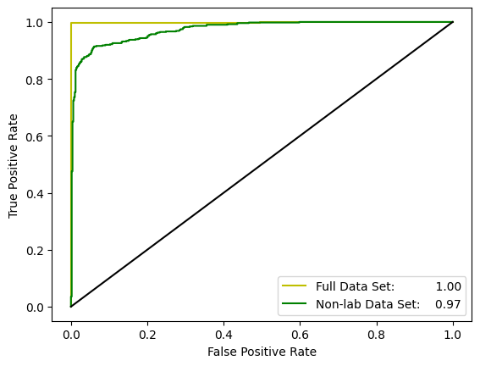
Model Analysis & Evaluation
Output analysis
#Plot the ROC Curves - ensure to use the predicted probabilities and not the predicted values
auc_valid = roc_auc_score(y_valid, y_valid_prob)
auc_nl_valid = roc_auc_score(y_nl_valid, y_nl_valid_prob)
fpr_valid, tpr_valid, thresholds_valid = roc_curve(y_valid, y_valid_prob)
fpr_nl_valid, tpr_nl_valid, thresholds_nl_valid = roc_curve(y_nl_valid, y_nl_valid_prob)
plt.plot(fpr_valid, tpr_valid,'y-', label = 'Full Data Set: %.2f'%auc_valid)
plt.plot(fpr_nl_valid, tpr_nl_valid,'g-', label = 'Non-lab Data Set: %.2f'%auc_nl_valid)
plt.plot([0,1],[0,1],'-k')
plt.xlabel('False Positive Rate')
plt.ylabel('True Positive Rate')
plt.legend()
plt.show()

Slide 34
Model Analysis & Evaluation
Feature Selection
#Feature selection
from sklearn.inspection import permutation_importance
perm_importance = permutation_importance(model, X_train, y_train)
sorted_idx = perm_importance.importances_mean.argsort()
plt.bar(X.columns[sorted_idx], perm_importance.importances_mean[sorted_idx])
plt.xlabel("Permutation Importance for Full Data")
plt.xticks(rotation=90)
plt.show()
print('')
print('')
perm_importance_nl = permutation_importance(model_nl, X_nl_train, y_nl_train)
sorted_idx_nl = perm_importance_nl.importances_mean.argsort()
plt.bar(X_nl.columns[sorted_idx_nl], perm_importance_nl.importances_mean[sorted_idx_nl])
plt.xlabel("Permutation Importance for Non-lab Data")
plt.xticks(rotation=90)
plt.show()

Slide 35
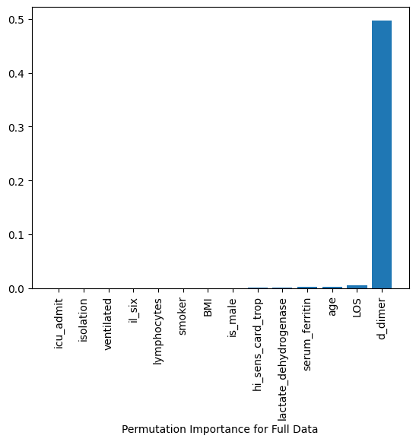
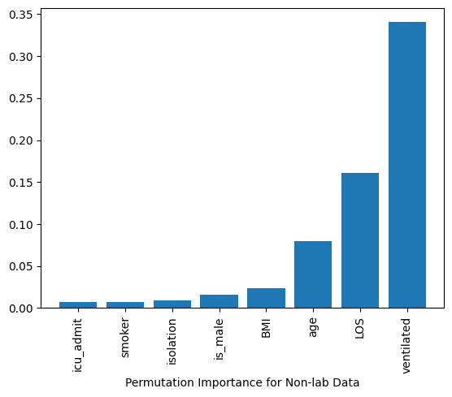
Model Analysis & Evaluation

Slide 36
Model Analysis & Evaluation
The model on the full data set has near-perfect forecasting ability which could raise some concern. Noting that the lab results are highly correlated with each other and with mortality, one could presume that dropping any single lab item would not materially impact the forecasting ability.
As such, when we look at various implementations of Explainable AI (XAI), we will use the model based on the non-lab items. Qualitatively, one could look at this model as one which has the most data available upon hospital admission as the lab results may take some time to complete. The non-lab feature model thus is a good snapshot at inception of patient admission to the hospital.

Slide 37
explainable AI to better understand the workings of the machine learning model

Slide 38
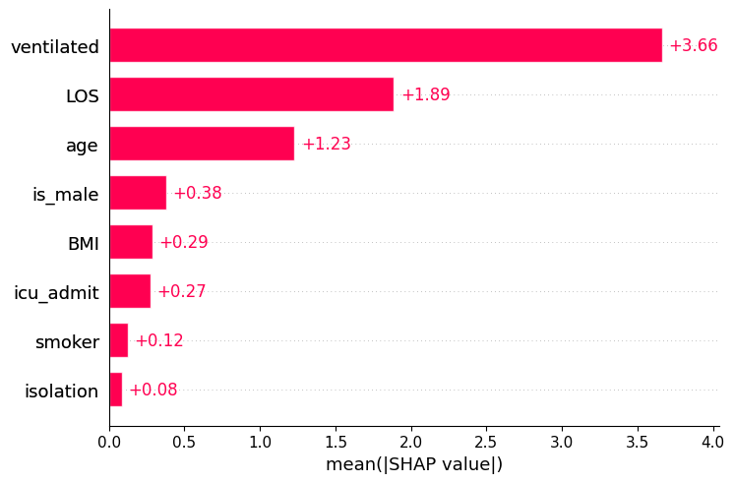
Explainable AI with Shapley
SHAP (SHapley Additive exPlanations): SHAP is a popular library for explaining individual predictions of machine learning models. It computes Shapley values, a method from cooperative game theory, to explain the contribution of each feature to the model's output.
!pip install shap
import shap
By default a SHAP bar plot will take the mean absolute value of each feature over all the instances (rows) of the dataset.
explainer_nl = shap.Explainer(model_nl, X_nl)
shap_values_nl = explainer_nl(X_nl)
plt.figure(figsize=(10, 6))
shap.plots.bar(shap_values_nl)
plt.show()

Slide 39
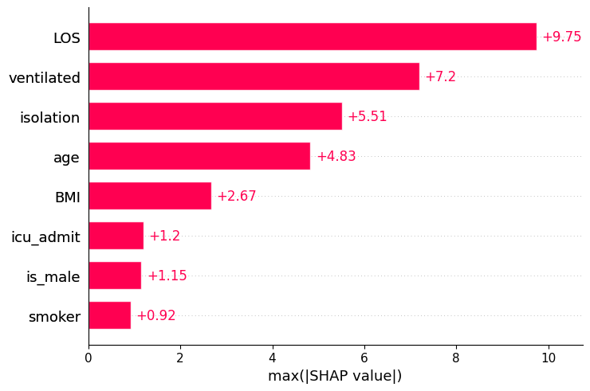
Explainable AI with Shapley
The mean absolute value is not the only way to create a global measure of feature importance, we can use any number of transforms. Here we show how using the max absolute value highlights the Capital Gain and Capital Loss features, since they have infrequent but high magnitude effects.
plt.figure(figsize=(10, 6))
shap.plots.bar(shap_values_nl.abs.max(0))
plt.show()

Slide 40
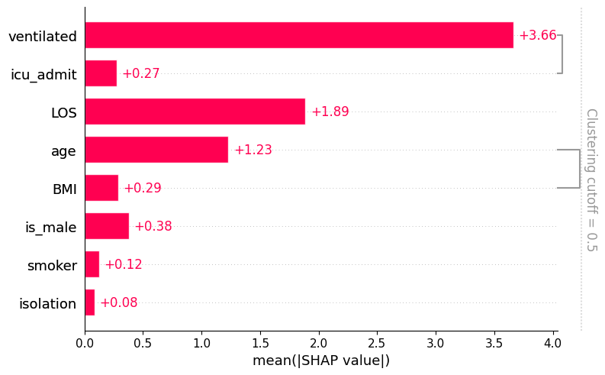
Explainable AI with Shapley
SHAP assesses correlated features by considering their joint contribution to the model's prediction. When features are correlated, their individual contributions may overlap, making it challenging to attribute the model's output to each feature independently.
To address this issue, SHAP uses a game-theoretic approach based on Shapley values, which assigns a fair share of the prediction's value to each feature based on its contribution, while considering interactions with other features. This allows SHAP to provide consistent and interpretable explanations even in the presence of correlated features.
SHAP takes into account the conditional expectations of features given other features, allowing it to capture the unique contribution of each feature while accounting for correlations with other features. By considering the interactions between correlated features, SHAP can provide insights into how changes in one feature affect the model's prediction, even when other correlated features are present.
#Let's look at any correlated features
clustering_nl = shap.utils.hclust(X_nl, Y_nl)
shap.plots.bar(shap_values_nl, clustering=clustering_nl)

Slide 41
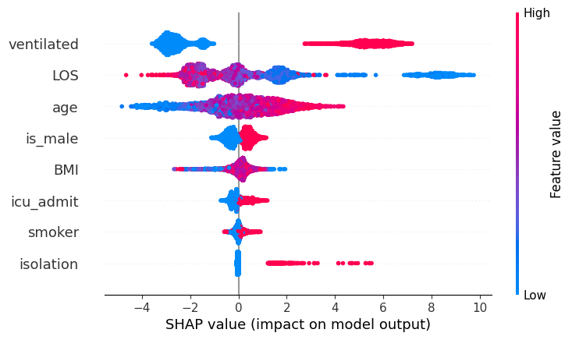
Explainable AI with Shapley
We can use a beeswarm plot to show the distribution of SHAP values for each feature across different samples in the dataset.
To interpret a beeswarm plot in SHAP, follow these steps:
Identify Features: Each vertical line in the plot represents a feature in your dataset. Look at the feature labels on the y-axis to identify which features are being displayed.
Distribution of SHAP Values: Each dot along a feature's line represents a single observation (sample) in your dataset. The position of the dot on the x-axis corresponds to the SHAP value for that feature and sample.
Impact on Prediction: Dots to the right of the center line indicate positive SHAP values, meaning they increase the model's prediction. Dots to the left indicate negative SHAP values, decreasing the prediction.
Density: The density of dots around a particular SHAP value indicates how frequently that value occurs across samples. Denser regions suggest more common SHAP values for that feature.
Outliers: Look for outliers, which are individual observations with extreme SHAP values compared to the rest of the dataset. These outliers may represent cases where the feature has an unusually strong or weak impact on the prediction.
Feature Importance: Consider the overall pattern of SHAP values for each feature. Features with consistently high or low SHAP values across many samples are likely to be more important for the model's predictions.
plt.figure(figsize=(10, 6))
shap.plots.beeswarm(shap_values_nl)
In analyzing the plot, we see that ventilation, length of stay (LOS), ICU admission, and isolation are all skewed to the right and may be viewed as relatively more predictive than the other features. Age and gender are centered right though have long left tails and could be viewed as less predictive, while smoker appears to be relatively centered around the 0-axis and as such would be expected to have little if any predictive ability.

Slide 42
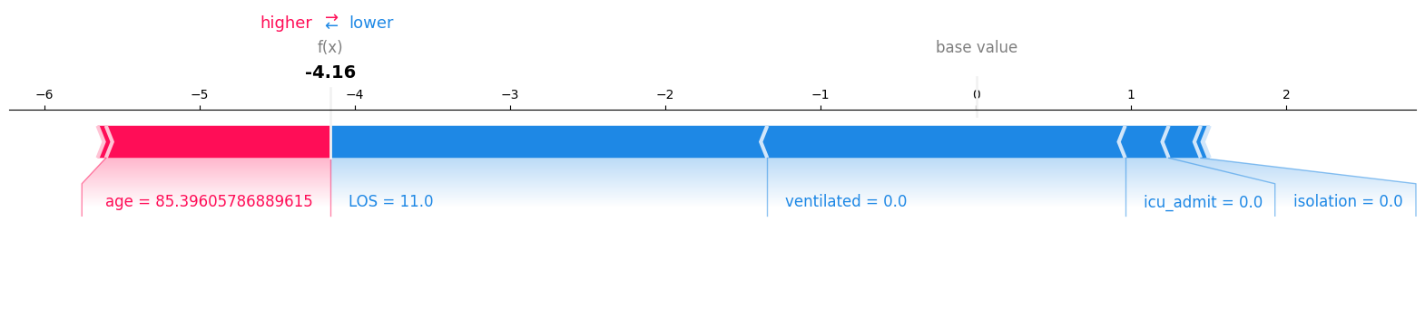
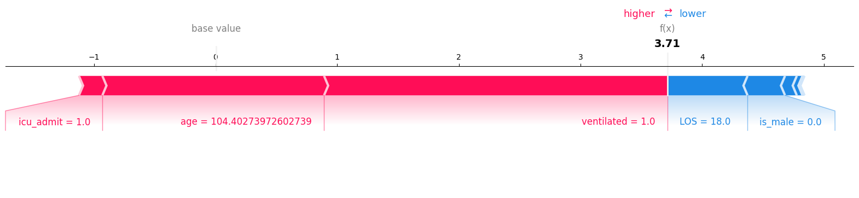
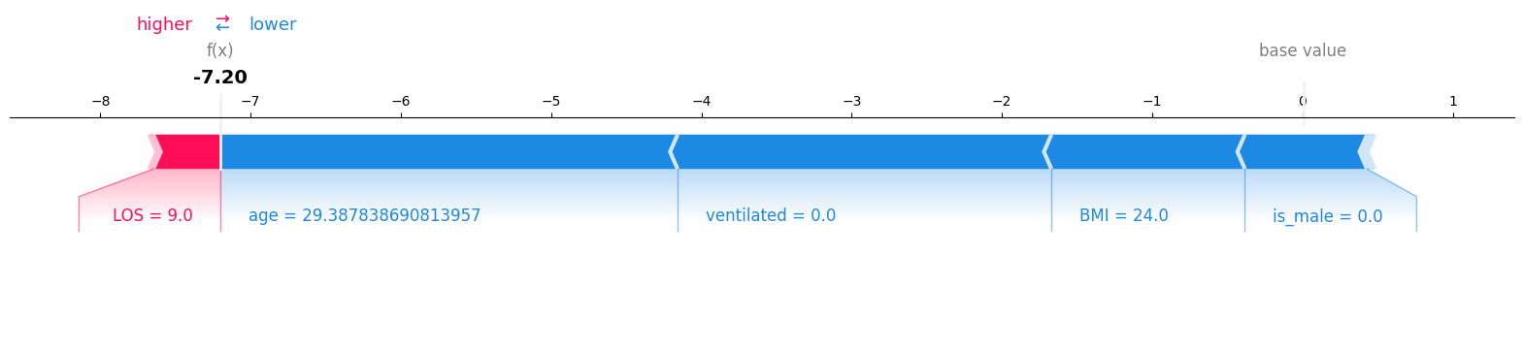
Explainable AI with Shapley
We can view a number of specific examples of local interpretation.
X_nl_test.head(5)
icu_admit | age | isolation | ventilated | LOS | smoker | BMI | is_male
0 | 85.39606 | 0 | 0 | 11 | 0.5 | 27 | 1
1 | 104.4027 | 0 | 1 | 18 | 0 | 28 | 0
1 | 85.67671 | 0 | 1 | 12 | 0 | 37 | 0
0 | 72.11387 | 0 | 0 | 12 | 0.5 | 28 | 1
0 | 44.70839 | 0 | 0 | 12 | 0.5 | 30 | 1
explainer = shap.TreeExplainer(model_nl)
shap_values = explainer.shap_values(X_nl_test)
feature_names=X_nl_test.columns.tolist()
#Select Specific Cases
selected_cases = [0, 1, 5]
#Generate Force Plot for Each Case
for case_idx in selected_cases:
shap.force_plot(
explainer.expected_value,
shap_values[case_idx],
X_nl_test.iloc[case_idx],
feature_names=feature_names,
matplotlib=True
)
plt.show()
print("\n\n")

Slide 43
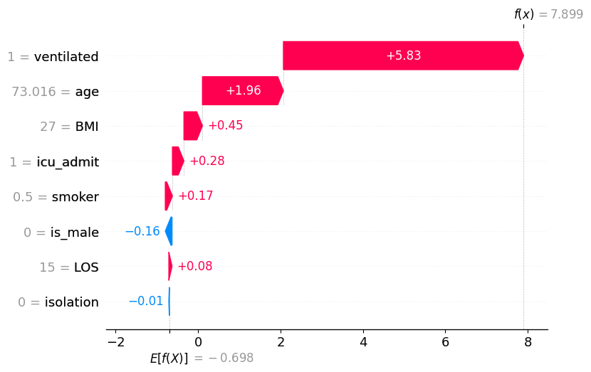
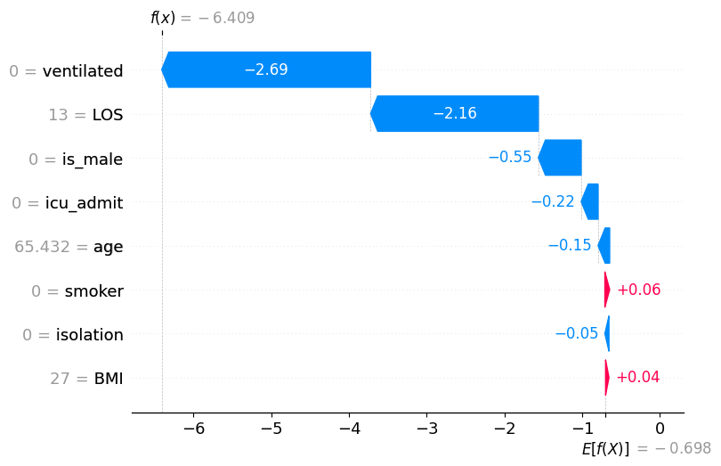
Explainable AI with Shapley
A SHAP waterfall plot describes the contribution of each feature to the final prediction made by a machine learning model for a specific instance. It illustrates how the predicted outcome changes as each feature's value deviates from a reference or baseline value. The plot begins with the model's base value, which is the average prediction across the dataset. Then, it shows the impact of each feature on the prediction, with bars representing the positive or negative contribution of each feature. The cumulative effect of these contributions results in the final prediction. Waterfall plots are useful for understanding the importance and directionality of individual features in the model's decision-making process for a given instance.
#Generate Waterfall Plot for a few random cases
#Define the size of the matplotlib figure
for case_idx in selected_cases:
shap.plots.waterfall(
shap_values_nl[case_idx]
)
plt.show()
print("\n\n")
Random case involving mortality
Random case involving survival

Slide 44
Explainable AI with LIME
Lime (Local Interpretable Model-agnostic Explanations): LIME is another library for explaining individual predictions of machine learning models. It provides locally faithful explanations by approximating complex models with interpretable surrogate models.
!pip install lime
from lime import lime_tabular
explainer_nl = lime_tabular.LimeTabularExplainer(
training_data=np.array(X_nl_train),
feature_names=X_nl_valid.columns,
class_names=['survival', 'death'],
mode='classification'
)

Slide 45
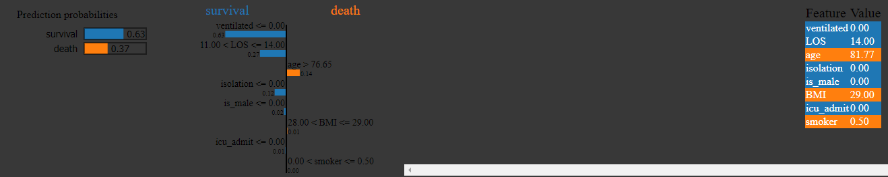
Explainable AI with LIME: Single Instance
Interpretability on a single instance
y_nl_test.head()
X_nl_test.head()
#change reference patient for death/survival
patient_id = 9
exp_nl = explainer_nl.explain_instance(
data_row=X_nl_test.iloc[patient_id],
predict_fn=model_nl.predict_proba
)
exp_nl.show_in_notebook(show_table=True)
The left-most bar plot is showing us the prediction probabilities, which can be treated as the model's confidence level in making the prediction.
The second visualization is probably the most important visualization which provides maximum explainability for each of the features.
The third visualization from the left shows the features and their respective values. Here, the features highlighted in orange are contributing toward class death, while features highlighted in blue are contributing toward class survival.

Slide 46
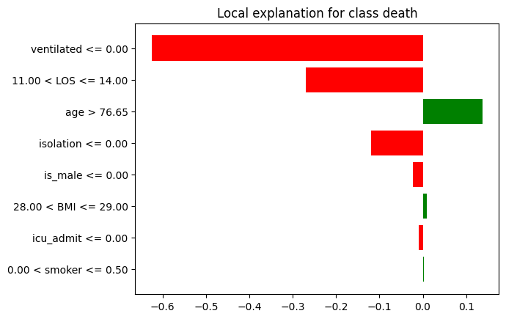
Explainable AI with LIME: Single Instance
Interpretability on a single instance
figure_nl = exp_nl.as_pyplot_figure(label = exp_nl.available_labels()[0])

Slide 47
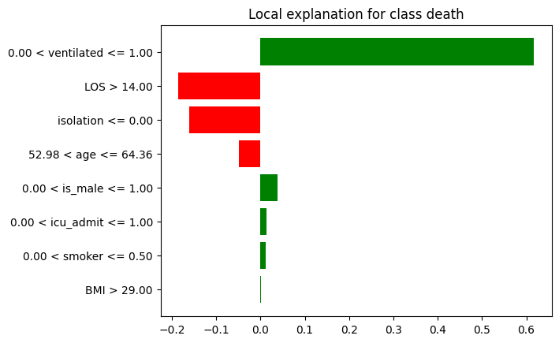
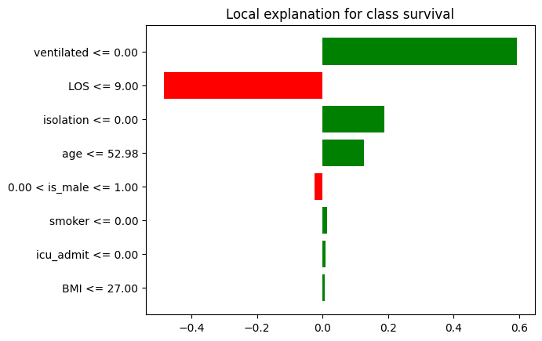
Explainable AI with LIME: Multiple Instances
Interpretability on a number of instances
# Let's use SP-LIME to return explanations on a few sample patients from the datasets and obtain a non-redundant global decision perspective of the black-box model
from lime import submodular_pick
sp_exp_nl = submodular_pick.SubmodularPick(explainer_nl,
final_covid_df[X_nl_train.columns].values,
predict_fn=model_nl.predict_proba,
num_features=8,
num_exps_desired=5)
print('SP-LIME Explanations on Non-lab Data Set examples.')
[exp_nl.show_in_notebook() for exp_nl in sp_exp_nl.sp_explanations]
[exp_nl.as_pyplot_figure(label=exp_nl.available_labels()[0]) for exp_nl in sp_exp_nl.sp_explanations]
print('SP-LIME Local Explanations on Non-lab Data Set')

Slide 48
Explainable AI with ELI5: Feature Importance
ELI5 (Explain Like I'm 5): ELI5 is a library that provides explanations for machine learning models at various levels of detail, including feature importances, permutation importances, and visualization of decision trees.
!pip install eli5
Feature importance is a popular XAI technique that helps us understand which features are most important in a machine learning model.
import eli5
# Compute feature importance using ELI5
eli5.show_weights(model_nl, feature_names=list(X_nl_train.columns))
Weight | Feature
0.8423 | ventilated
0.0747 | LOS
0.0360 | isolation
0.0118 | age
0.0102 | is_male
0.0091 | icu_admit
0.0086 | smoker
0.0071 | BMI
Feature importance in ELI5 analyzes the relative contribution of each feature in a machine learning model's predictions. It helps identify which features have the most influence on the model's output and provides insights into the factors driving the model's decisions.
ELI5 calculates feature importance by analyzing how much each feature contributes to the model's prediction for each instance in the dataset. It considers both the magnitude and direction of the impact of each feature on the prediction.
Understanding feature importance can help users interpret the model's behavior, identify key drivers of the outcome, and prioritize features for further analysis or feature engineering.

Slide 49
Explainable AI with ELI5: Permutation Importance
Permutation importance is similar to feature importance, but instead of fitting a new model for each feature, it randomly permutes each feature and measures the resulting decrease in model performance. This can help us identify features that are most important to the model's performance.
from eli5.sklearn import PermutationImportance
# Compute permutation importance using ELI5
perm_nl = PermutationImportance(model_nl).fit(X_nl_test, y_nl_test)
eli5.show_weights(perm_nl, feature_names=list(X_nl_test.columns))
Weight | Feature
0.3471 ± 0.0308 | ventilated
0.1227 ± 0.0183 | LOS
0.0305 ± 0.0090 | age
0.0089 ± 0.0059 | isolation
0.0057 ± 0.0034 | is_male
0.0040 ± 0.0013 | icu_admit
0.0008 ± 0.0023 | smoker
-0.0018 ± 0.0088 | BMI
Permutation importance in ELI5 tells us the importance of each feature by evaluating how much the model's performance decreases when the values of that feature are randomly shuffled.
The original model's performance metric (e.g. AUC) is calculated on a validation set or through cross-validation
The values of one feature at a time are randomly shuffled in the validation set.
The model's performance metric is recalculated using the modified validation set.
The difference between the original performance metric and the shuffled performance metric represents the importance of that feature. Larger decreases in performance indicate that the feature is more important.

Slide 50
Explainable AI with ELI5
ELI5 also provides tools for generating textual explanations for machine learning models. Textual explanations can help us understand how a model arrived at a particular decision or prediction.
# Generate a textual explanation using ELI5
eli5.show_prediction(model_nl, X_nl_test.iloc[2], target_names=["survived", "died"])
y=died (probability 0.986, score 4.224) top features
Contribution | Feature
+3.855 | ventilated
+1.220 | LOS
+0.607 | icu_admit
+0.376 | age
+0.069 | is_male
+0.008 | <BIAS>
-0.034 | isolation
-0.203 | smoker
-1.674 | BMI
We can see that the model predicts a 98.6% probability of death in this case with ventilation, LOS, and ICU admission being the primary contributors to this prediction.

Slide 51
Using Glassbox and blackbox modeling with interpretml

Slide 52
Explainable AI with InterpretML
InterpretML: InterpretML is a library developed by Microsoft Research that offers a suite of interpretability techniques, including global feature importance, local explanations, and explanations for model predictions.
!pip install interpret

Slide 53
Explainable AI with InterpretML: Glassbox EBM
Glassbox models can provide explanations on a both global (overall behavior) and local (individual predictions) level.
Global explanations are useful for understanding what a model finds important, as well as identifying potential flaws in its decision making.
Explainable Boosting Machine (EBM) is a tree-based, cyclic gradient boosting Generalized Additive Model with automatic interaction detection. This makes EBMs as accurate as state-of-the-art techniques like random forests and gradient boosted trees. However, unlike these blackbox models, EBMs produce exact explanations and are editable by domain experts.
from interpret import set_visualize_provider
from interpret.provider import InlineProvider
set_visualize_provider(InlineProvider())
from interpret.glassbox import ExplainableBoostingClassifier
from interpret import show
ebm = ExplainableBoostingClassifier()
ebm.fit(X_nl_train, y_nl_train)

Slide 54
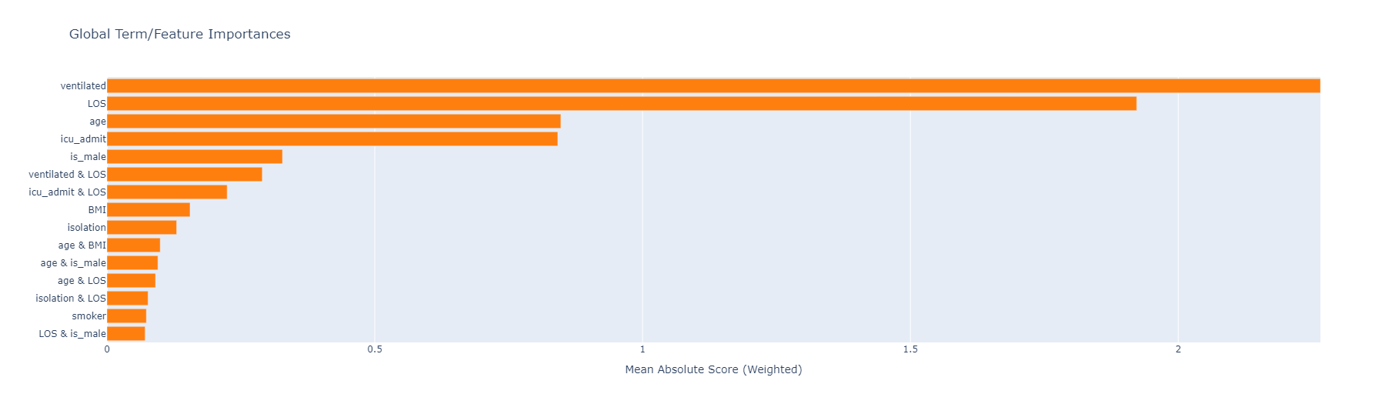
Explainable AI with InterpretML: Glassbox EBM
ebm_explanation = ebm.explain_global()
plotly_fig = ebm_explanation.visualize()
plotly_fig.show()

Slide 55
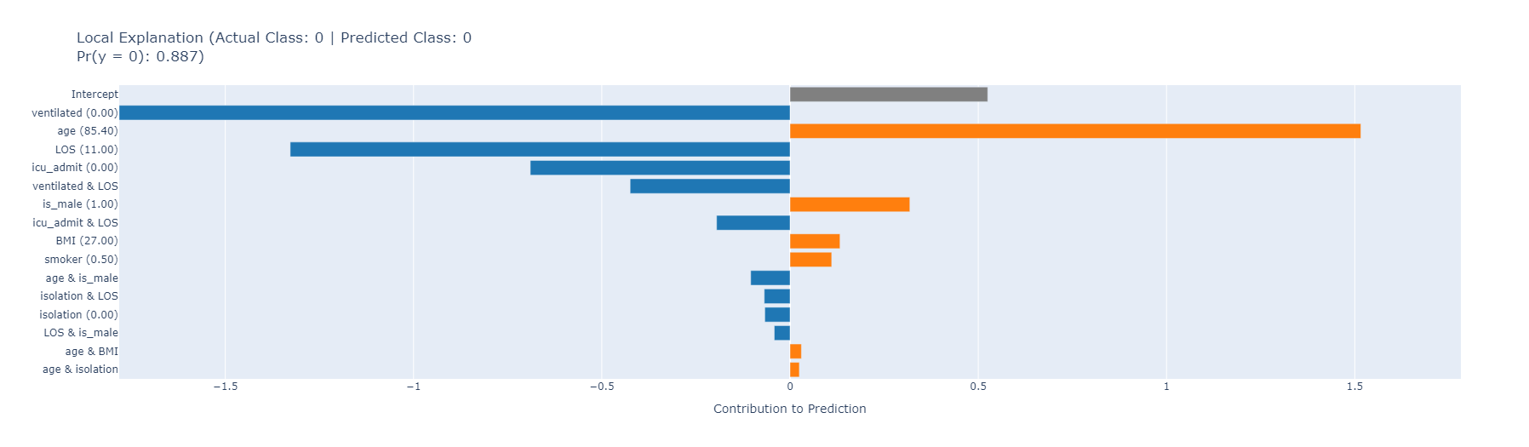
Explainable AI with InterpretML: Glassbox EBM
ebm_explanation = ebm.explain_local(X_nl_test[:5], y_nl_test[:5])
plotly_fig = ebm_explanation.visualize(0)
plotly_fig.show()

Slide 56
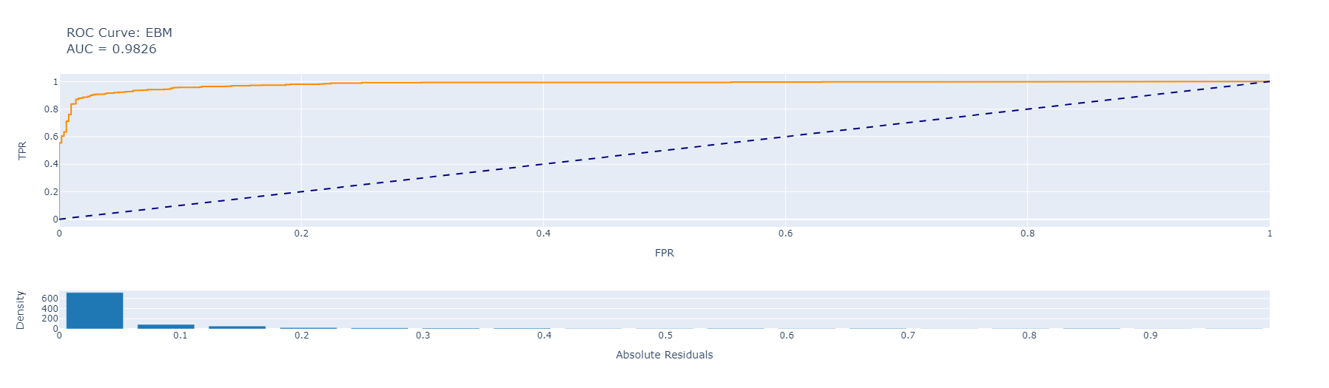
Explainable AI with InterpretML: Glassbox EBM
Evaluate EBM performance
from interpret.perf import ROC
#ebm_perf = ROC(ebm).explain_perf(X_nl_test, y_nl_test, name='EBM')
#show(ebm_perf)
#plt.show(ebm_perf)
ebm_perf = ROC(ebm).explain_perf(X_nl_test, y_nl_test, name='EBM')
plotly_fig = ebm_perf.visualize()
plotly_fig.show()

Slide 57
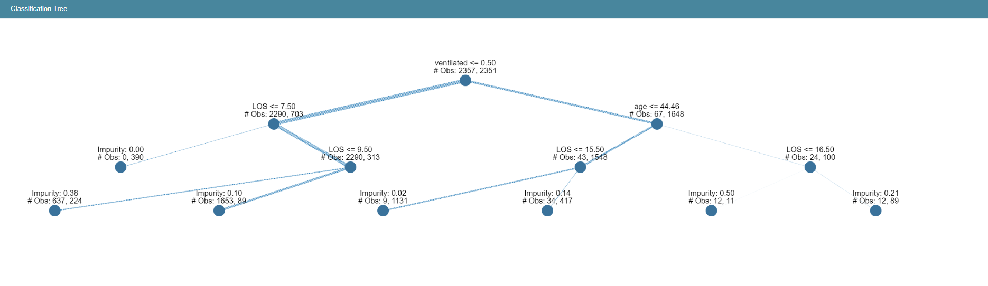
Explainable AI with InterpretML: Decision Tree
from interpret.glassbox import ClassificationTree
tree = ClassificationTree()
tree.fit(X_nl_train, y_nl_train)
tree_global = tree.explain_global(name='Classification Tree')
show(tree_global)
#note that the rendering method show does not always run for multiple code executions

Slide 58
Explainable AI with InterpretML: Blackbox PCA
Build a Blackbox Pipeline
Blackbox interpretability methods can extract explanations from any machine learning pipeline. This includes model ensembles, pre-processing steps, and complex models such as deep neural nets.
from sklearn.decomposition import PCA
from sklearn.pipeline import Pipeline
pca = PCA()
blackbox_model = Pipeline([('pca', pca), ('model', model_nl)])
blackbox_model.fit(X_nl_train, y_nl_train)

Slide 59
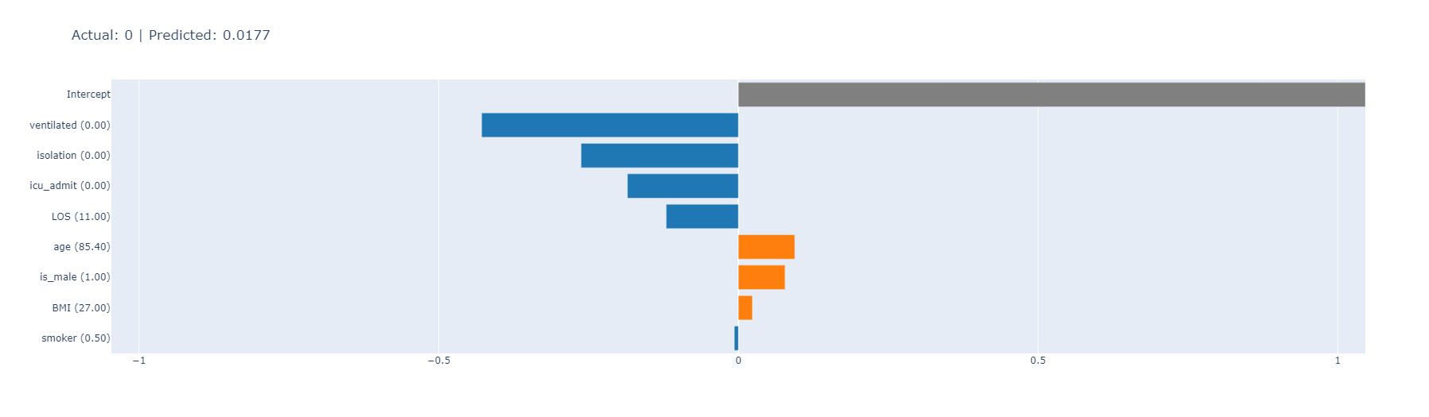
Explainable AI with InterpretML: Blackbox PCA
Explain the Blackbox
from interpret.blackbox import LimeTabular
from interpret import show
lime = LimeTabular(blackbox_model, X_nl_train, random_state=seed)
#show(lime.explain_local(X_nl_test[:5], y_nl_test[:5]), 0)
lime_explanation = lime.explain_local(X_nl_test[:5], y_nl_test[:5])
plotly_fig = lime_explanation.visualize(0)
plotly_fig.show()

Slide 60
Replacing XGBoost with a Deep Learning Model and running XAI

Slide 61
Converting XGBoost to Deep Learning and running XAI
import tensorflow as tf
# Define a simple neural network
model_nns = tf.keras.Sequential([
tf.keras.layers.Dense(64, activation='relu', input_shape=(X_nl_train.shape[1],)),
tf.keras.layers.Dense(1, activation='sigmoid')
])
# Compile the model
model_nns.compile(optimizer='adam',
loss='binary_crossentropy',
metrics=['AUC'])
x_train_tensor = tf.convert_to_tensor(X_nl_train)
y_train_tensor = tf.convert_to_tensor(model_nl.predict(X_nl_train))
# Train the neural network (using XGBoost predictions as labels)
model_nns.fit(x_train_tensor, y_train_tensor, epochs=10, batch_size=32)

Slide 62
Converting XGBoost to Deep Learning and running XAI
X_nl_valid_reshaped = X_nl_valid.values.reshape((-1, 6))
outputs = model_nns(X_nl_valid_reshaped)
#Neural network models predict continuous variables so we need to round the output
rounded_outputs = []
for output in outputs:
if output > 0.85:
rounded_outputs.append(1)
else:
rounded_outputs.append(0)
# Calculate the AUC score
results_nns = roc_auc_score(rounded_outputs, y_nl_valid)
print('Model AUC: ', results_nns)
Model AUC: 0.5967477542456232
An AUC score of 0.597 indicates that the model's discriminatory ability is slightly better than random chance in binary classification tasks. Several factors could influence the model's performance, including data quality, feature selection, and the complexity of the model architecture. Despite its modest performance, the model may still offer valuable insights or fulfill its intended purpose adequately, depending on the context. Analyzing the model's weaknesses and identifying areas for improvement can guide future iterations. While a score of 0.60 may not meet desired thresholds, it represents a valuable learning opportunity and underscores the iterative nature of machine learning model development. We will now construct a more complex neural net model to determine if we can increase AUC and then perform XAI using Captum.

Slide 63
Explainable AI with Captum
Captum is a PyTorch-based library for model interpretability in machine learning. It offers a suite of algorithms and tools designed to help users understand and interpret the decisions made by deep learning models.
#scikit-learn related imports
import sklearn
from sklearn.metrics import mean_squared_error
# pytorch relates imports
import torch
import torch.nn as nn
import torch.optim as optim
# imports from captum library
!pip install captum
import captum
from captum.attr import LayerConductance, LayerActivation, LayerIntegratedGradients
from captum.attr import IntegratedGradients, DeepLift, GradientShap, NoiseTunnel, FeatureAblation
torch.manual_seed(1234)
np.random.seed(1234)

Slide 64
Explainable AI with Captum
Tensorizing Inputs and creating batches
X_nn_train = torch.tensor(X_nl_train.values).float()
y_nn_train = torch.tensor(y_nl_train.values).view(-1, 1).float()
X_nn_test = torch.tensor(X_nl_test.values).float()
y_nn_test = torch.tensor(y_nl_test.values).view(-1, 1).float()
X_nn_valid = torch.tensor(X_nl_valid.values).float()
y_nn_valid = torch.tensor(y_nl_valid.values).view(-1, 1).float()
datasets_nn = torch.utils.data.TensorDataset(X_nn_train, y_nn_train)
train_iter_nn = torch.utils.data.DataLoader(datasets_nn, batch_size=10, shuffle=True)

Slide 65
Explainable AI with Captum: Model setup
#Defining default hyper parameters for the model.
batch_size = 50
num_epochs = 200
learning_rate = 0.0001
size_hidden1 = 100
size_hidden2 = 50
size_hidden3 = 10
size_hidden4 = 1
#Define the new NN model
class CovidMortalityModel(nn.Module):
def __init__(self):
super().__init__()
self.lin1 = nn.Linear(len(X_nl_train.columns), size_hidden1)
self.relu1 = nn.ReLU()
self.lin2 = nn.Linear(size_hidden1, size_hidden2)
self.relu2 = nn.ReLU()
self.lin3 = nn.Linear(size_hidden2, size_hidden3)
self.relu3 = nn.ReLU()
self.lin4 = nn.Linear(size_hidden3, size_hidden4)
def forward(self, input):
return self.lin4(self.relu3(self.lin3(self.relu2(self.lin2(self.relu1(self.lin1(input)))))))

Slide 66
Explainable AI with Captum: Model training
#Model training
model_nn = CovidMortalityModel()
model_nn.train()
#Defining the loss function that will be used for optimization" Binary Cross-Entropy/Log Loss
criterion = nn.L1Loss(reduction='sum')

Slide 67
Explainable AI with Captum: Model training
def train(model_inp, num_epochs = num_epochs):
# optimizer = tf.optimizers.AdamW(model_inp.parameters(), learning_rate=learning_rate)
optimizer = torch.optim.AdamW(model_inp.parameters(), lr=learning_rate)
for epoch in range(num_epochs): # loop over the dataset multiple times
running_loss = 0.0
for inputs, labels in train_iter_nn:
# forward pass
outputs = model_inp(inputs)
# defining loss
loss = criterion(outputs, labels)
# zero the parameter gradients
optimizer.zero_grad()
# computing gradients
loss.backward()
# accumulating running loss
running_loss += loss.item()
# updated weights based on computed gradients
optimizer.step()
if epoch % 20 == 0:
print('Epoch [%d]/[%d] running accumulative loss across all batches: %.3f' %
(epoch + 1, num_epochs, running_loss))
running_loss = 0.0
train(model_nn)

Slide 68
Explainable AI with Captum: Model evaluation
model_nn.eval()
outputs = model_nn(X_nn_test)
#Neural network models predict continuous variables so we need to round the output
rounded_outputs = []
for output in outputs:
if output > 0.85:
rounded_outputs.append(1)
else:
rounded_outputs.append(0)
# Calculate the AUC score
results_nn = roc_auc_score(rounded_outputs, y_nn_test)
print('Model AUC: ', results_nn)
Model AUC: 0.927302433298436
The improvement from an AUC score of 060 to 0.93 with the more complex neural network model suggests a notable enhancement in performance. This increase indicates that the complex model has a higher discriminatory power and is better at distinguishing between classes compared to the simpler model. The higher AUC score signifies improved accuracy and effectiveness in predicting outcomes. However, it's essential to consider the trade-offs associated with complexity, such as increased computational resources and potential overfitting risks. Overall, the enhancement demonstrates the effectiveness of leveraging a more sophisticated architecture for achieving better predictive performance in the given task.

Slide 69
Explainable AI with Captum: Comparing different attribution algorithms
ig = IntegratedGradients(model_nn)
ig_nt = NoiseTunnel(ig)
dl = DeepLift(model_nn)
gs = GradientShap(model_nn)
fa = FeatureAblation(model_nn)
ig_attr_test = ig.attribute(X_nn_test, n_steps=50)
ig_nt_attr_test = ig_nt.attribute(X_nn_test)
dl_attr_test = dl.attribute(X_nn_test)
gs_attr_test = gs.attribute(X_nn_test, X_nn_train)
fa_attr_test = fa.attribute(X_nn_test)

Slide 70
Explainable AI with Captum: Comparing different attribution algorithms
# prepare attributions for visualization
x_axis_data = np.arange(X_nl_test.shape[1])
x_axis_data_labels = list(map(lambda idx: feature_names[idx], x_axis_data))
ig_attr_test_sum = ig_attr_test.detach().numpy().sum(0)
ig_attr_test_norm_sum = ig_attr_test_sum / np.linalg.norm(ig_attr_test_sum, ord=1)
ig_nt_attr_test_sum = ig_nt_attr_test.detach().numpy().sum(0)
ig_nt_attr_test_norm_sum = ig_nt_attr_test_sum / np.linalg.norm(ig_nt_attr_test_sum, ord=1)
dl_attr_test_sum = dl_attr_test.detach().numpy().sum(0)
dl_attr_test_norm_sum = dl_attr_test_sum / np.linalg.norm(dl_attr_test_sum, ord=1)
gs_attr_test_sum = gs_attr_test.detach().numpy().sum(0)
gs_attr_test_norm_sum = gs_attr_test_sum / np.linalg.norm(gs_attr_test_sum, ord=1)
fa_attr_test_sum = fa_attr_test.detach().numpy().sum(0)
fa_attr_test_norm_sum = fa_attr_test_sum / np.linalg.norm(fa_attr_test_sum, ord=1)
lin_weight = model_nn.lin1.weight[0].detach().numpy()
y_axis_lin_weight = lin_weight / np.linalg.norm(lin_weight, ord=1)
width = 0.14
legends = ['Int Grads', 'Int Grads w/SmoothGrad','DeepLift', 'GradientSHAP', 'Feature Ablation', 'Weights']
plt.figure(figsize=(10, 10))
ax = plt.subplot()
ax.set_title('Comparing input feature importances across multiple algorithms and learned weights')
ax.set_ylabel('Attributions')
FONT_SIZE = 12
plt.rc('font', size=FONT_SIZE) # fontsize of the text sizes
plt.rc('axes', titlesize=FONT_SIZE) # fontsize of the axes title
plt.rc('axes', labelsize=FONT_SIZE) # fontsize of the x and y labels
plt.rc('legend', fontsize=FONT_SIZE-4) # fontsize of the legend
ax.bar(x_axis_data, ig_attr_test_norm_sum, width, align='center', alpha=0.8, color='#eb5e7c')
ax.bar(x_axis_data + width, ig_nt_attr_test_norm_sum, width, align='center', alpha=0.7, color='#A90000')
ax.bar(x_axis_data + 2 * width, dl_attr_test_norm_sum, width, align='center', alpha=0.6, color='#34b8e0')
ax.bar(x_axis_data + 3 * width, gs_attr_test_norm_sum, width, align='center', alpha=0.8, color='#4260f5')
ax.bar(x_axis_data + 4 * width, fa_attr_test_norm_sum, width, align='center', alpha=1.0, color='#49ba81')
ax.bar(x_axis_data + 5 * width, y_axis_lin_weight, width, align='center', alpha=1.0, color='grey')
ax.autoscale_view()
plt.tight_layout()
ax.set_xticks(x_axis_data + 0.5)
ax.set_xticklabels(x_axis_data_labels)
plt.legend(legends, loc=3)
plt.show()

Slide 71
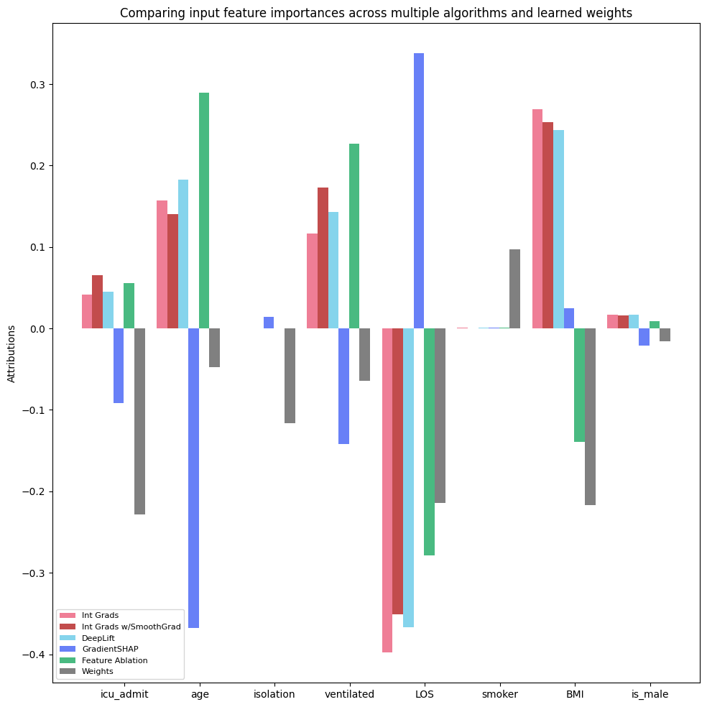
Explainable AI with Captum: Comparing different attribution algorithms
The magnitudes of learned model weights serve to explain the correlations between the dependent variable (mortality) and each independent variable (features). A weight of zero signifies no correlation, while positive weights suggest positive correlations and negative weights imply the opposite. Due to the network's multilayer architecture, these weights may not directly reflect correlations with mortality. While weight magnitudes provide valuable insights into feature importance, their interpretation should be nuanced, considering the network's complexity and potential interactions between layers and features.
Captum's explainable AI techniques can offer deeper understanding by evaluating how individual features contribute to model predictions, enhancing transparency and interpretability in AI models.
Since the neural network has more than one layer the weights might not be directly correlated with mortality.
Generally speaking, we see that age, ventilation, ICU admissions, and BMI have positive feature importance with mortality across the various algorithms. One notable outlier is in length of stay (LOS) which has consistently negative contributions. This could be the result of noise in the data feature and warrants further explanation and perhaps refinement during feature engineering. The Gradient SHAP algorithm also appears to have some anomalous feature importance in ICU admission, age, ventilation, and length of stay (LOS) relative to the other algorithms.

Slide 72
Explainable AI with Captum: Layer Attribution & Model Weights
# Compute the attributions of the output with respect to the inputs of the fourth linear layer
lc = LayerConductance(model_nn, model_nn.lin4)
# shape: test_examples x size_hidden
lc_attr_test = lc.attribute(X_nn_test, n_steps=100, attribute_to_layer_input=True)
# weights from forth linear layer
# shape: size_hidden4 x size_hidden3
lin4_weight = model_nn.lin4.weight
plt.figure(figsize=(10, 10))
x_axis_data = np.arange(lc_attr_test.shape[1])
y_axis_lc_attr_test = lc_attr_test.mean(0).detach().numpy()
y_axis_lc_attr_test = y_axis_lc_attr_test / np.linalg.norm(y_axis_lc_attr_test, ord=1)
y_axis_lin4_weight = lin4_weight[0].detach().numpy()
y_axis_lin4_weight = y_axis_lin4_weight / np.linalg.norm(y_axis_lin4_weight, ord=1)
width = 0.25
legends = ['Attributions','Weights']
x_axis_labels = [ 'Neuron {}'.format(i) for i in range(len(y_axis_lin4_weight))]
ax = plt.subplot()
ax.set_title('Aggregated neuron importances and learned weights in the last linear layer of the model')
ax.bar(x_axis_data + width, y_axis_lc_attr_test, width, align='center', alpha=0.5, color='red')
ax.bar(x_axis_data + 2 * width, y_axis_lin4_weight, width, align='center', alpha=0.5, color='green')
plt.legend(legends, loc=1, prop={'size': FONT_SIZE})
ax.autoscale_view()
plt.tight_layout()
ax.set_xticks(x_axis_data + 0.5)
ax.set_xticklabels(x_axis_labels)
plt.show()

Slide 73
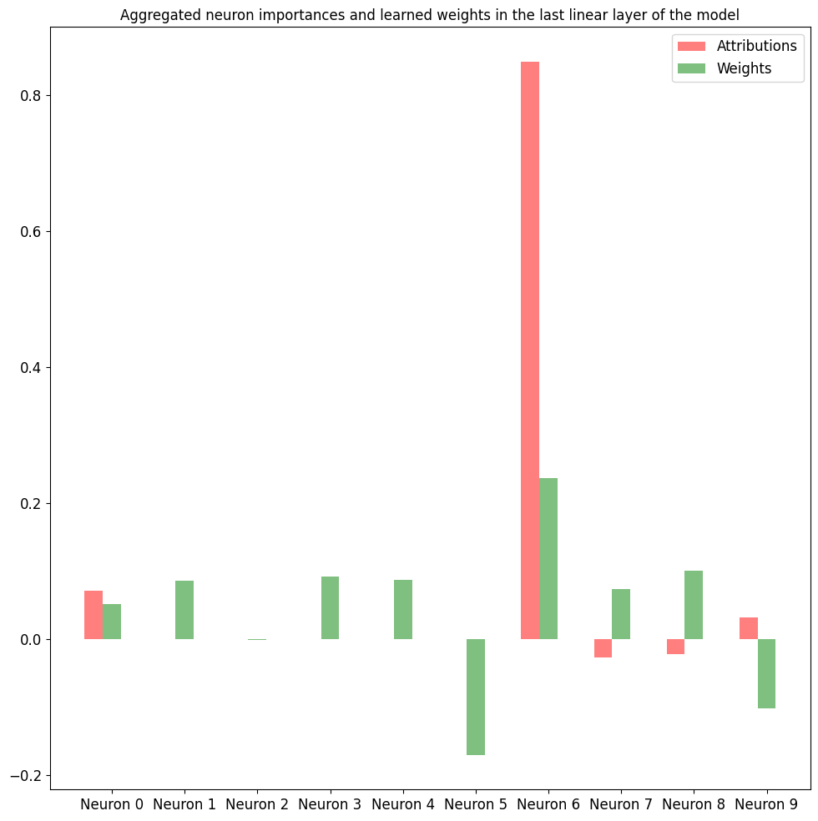
Explainable AI with Captum: Layer Attribution & Model Weights
Captum is also able to attribute to specific layers and their associated neurons. In the example to the right, we are looking at the relative importance for all 10 neurons in the fourth layer of the network.
We notice that the attribution score for some neurons is zero, with the notable case of the 5th neuron (Neuron 6) having both a large attribution and large weight.
In general, fluctuations in attribution are greater than for weight across neurons.

Slide 74
Acknowledgements
Jason Walonoski, Mark Kramer, Joseph Nichols, Andre Quina, Chris Moesel, Dylan Hall, Carlton Duffett, Kudakwashe Dube, Thomas Gallagher, Scott McLachlan, Synthea: An approach, method, and software mechanism for generating synthetic patients and the synthetic electronic health care record, Journal of the American Medical Informatics Association, Volume 25, Issue 3, March 2018, Pages 230–238, https://doi.org/10.1093/jamia/ocx079
Walonoski J, Klaus S, Granger E, Hall D, Gregorowicz A, Neyarapally G, Watson A, Eastman J. Synthea™ Novel coronavirus (COVID-19) model and synthetic data set. Intelligence-Based Medicine. 2020 Nov;1:100007. https://doi.org/10.1016/j.ibmed.2020.100007

